Slide 1

Food and Mood
AultCare Wellness

Slide 2
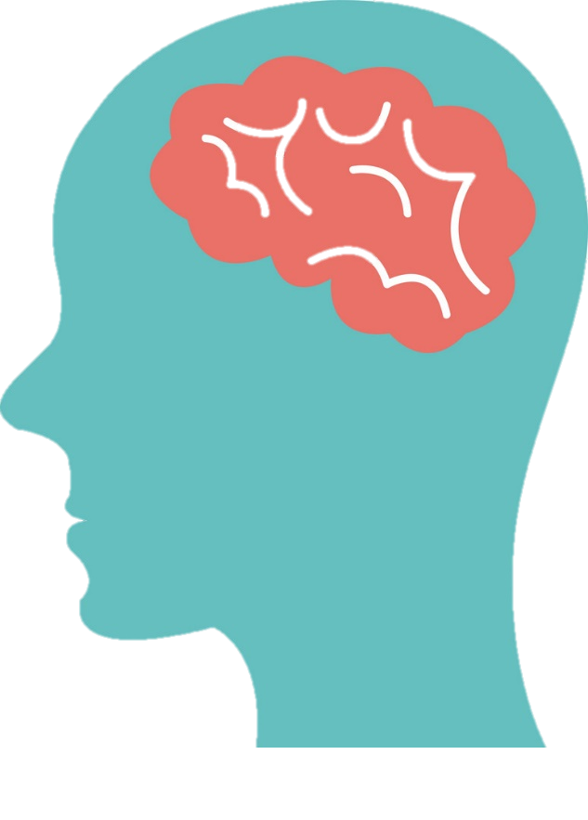
Human Brain
The brain demands a constant supply of energy; approximately 20% of our daily caloric needs are used by the brain.
What we eat directly affects the structure and function of our brains and ultimately our mood.

Slide 3
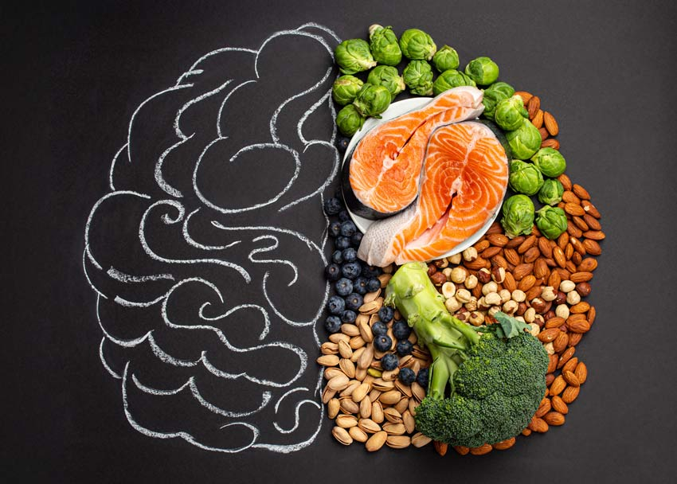
Human Brain continued
The human brain operates at a very high metabolic rate and depends on proteins, fats, vitamins, minerals, and trace elements.
The brain requires a solid diet of phytonutrient rich foods in order to perform at its optimal level.
Notes:
High fat, high sugar diets can affect proteins that are important in brain development like neurotrophic factor which is reduced in depression

Slide 4
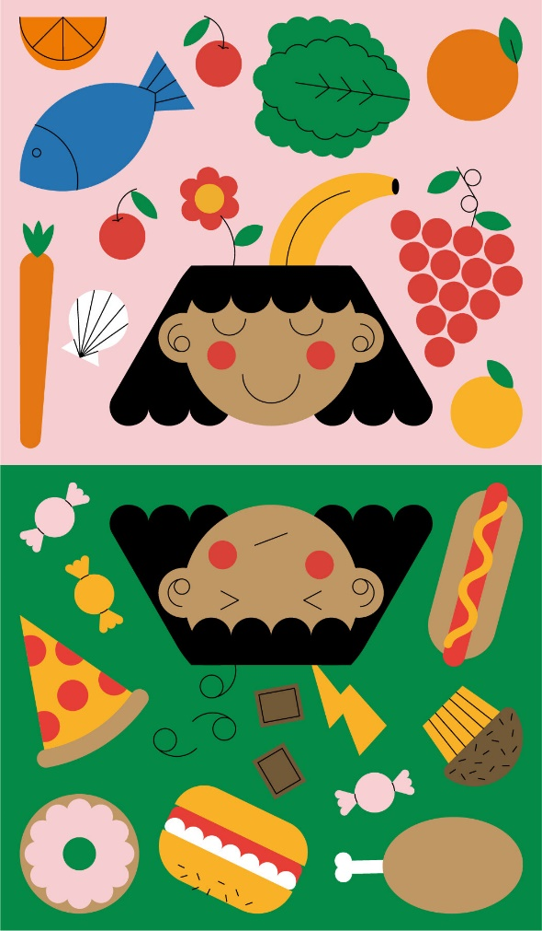
What can affect mood?
Eating behaviors 100% affect mood.
  Humans are community based creatures
  Isolation
  Stress
Food quality affects mood.
  Processed and ultra processed
  Patterns high in red/processed meat
  Refined grains, sweets, sugars
  Low in fruits and vegetables
Notes:
Negative moods states happen to all of us. Stress, bad news, disappointments, loss, etc all can cause a negative mood state.

Slide 5
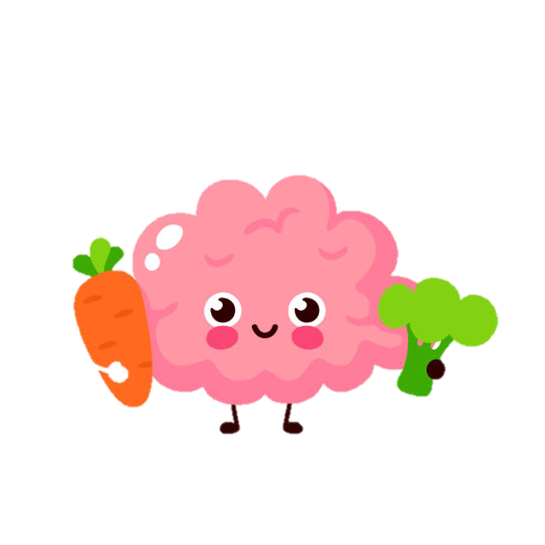
Negative moods
Poor mood states create the desire for high sugar, fat, and salt resulting in decreased intakes of these brain essential nutrients:
  B vitamins
  Zinc
  Folate
  Magnesium

Slide 6
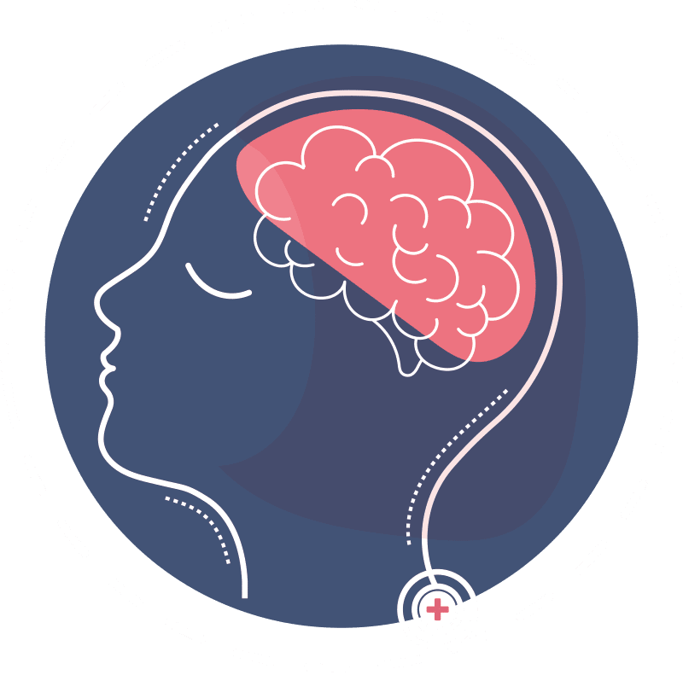
Facts and Statistics
Nearly 1 in 5 adults (46.6 million people) in the U.S. live with some form of mental illness.
Mental Illness is any condition that changes a person’s thinking, feelings, and/or behavior and causes distress and difficulty in functioning.

Slide 7
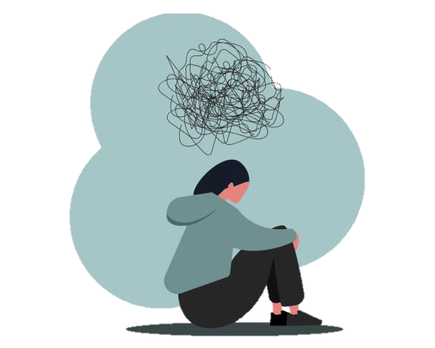
Facts and Statistics continued
Current treatment of depressive symptoms
  Primarily medication use
  Psychotherapy which manage less than ½ of the mental illness cases.
Evidence suggests diet is as important to brain health as it is to heart, pancreas, and digestive system health.

Slide 8
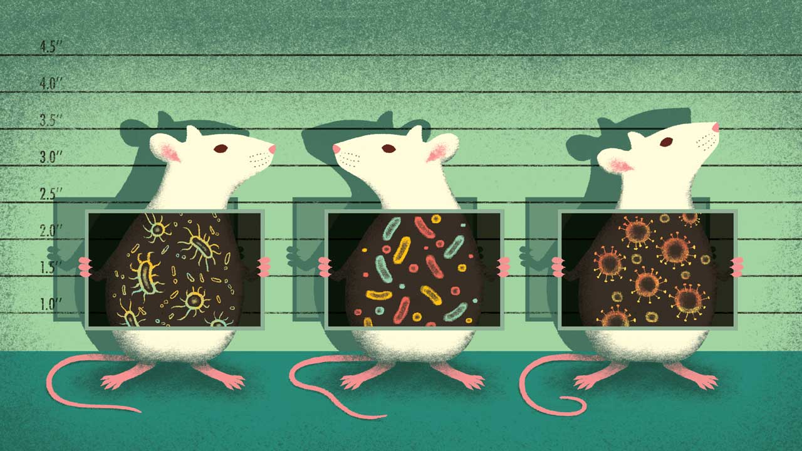
Mice Study of Microbiota
Gut bacteria of depressed mice were implanted in the gut of healthy mice and the healthy mice displayed depressive symptoms.

Slide 9
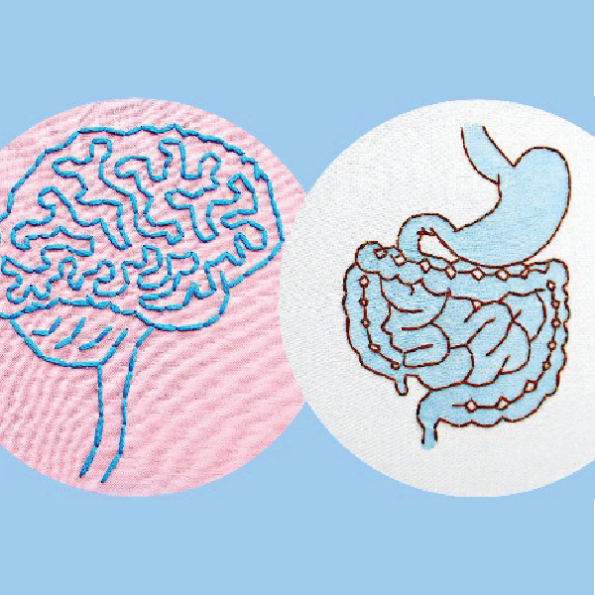
Gut Brain Connection
Connection between the gut and brain.
The gut is known as the body’s “second brain.”
Notes:
Gut/brain axis: there is direct communication of signals between the gut and brain through the vagus nerve.
Microbiota of the stomach can influence levels of inflammation and neurotransmitters
The gut produces 95% of the bodies serotonin; the hormone that regulates sleep, mood, appetite, and inhibits pain.

Slide 10
Food/Mood Relationship
The relationship between depression and diet is bidirectional:
  High quality diet, less depressive symptoms.
  Depression, consume lower quality diet
  Fatigue, lack motivation
Notes:
Feelings of fatigue and lack of motivation associated with depressive symptoms affect motivation to engage in healthy dietary habits, cook, or grocery shop

Slide 11
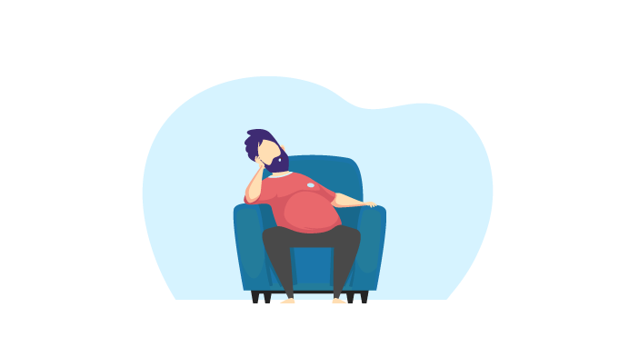
Link Between Obesity and Depression
Obesity and depression are two of the most prevalent health issues in society.
  There is a strong link between obesity and depression.
  Obese individuals have a 25% chance of experiencing some form of mood or anxiety disorder.
  Depressed individuals have been shown to have reduced activity in the reward centers of their brains.
Notes:
Not all depression is associated with obesity. However, there is a strong association between obesity and depression that is difficult to define, nonetheless ever present. In either case, we are not listening to our organisms cues for hunger, fullness, or maybe those cue’s are not working. First lets take a look at what hunger actually means
The association is not clear. Either people are depressed and anxious because they have gained weight and are dealing with a sense of moral failing. OR, have they gained weight d/t being anxious and depressed?
Perhaps they use food to diminish unwanted emotional states.
While those were questions in 2009, evidence and studies have suggested the answer is that anxiety and depression can be caused by poor dietary intake and prevention of depression can include

Slide 12
Appetite
The desire for food at times when the body is not in need of fuel.
  Learned response to food
  Triggered availability, exposure, and sensory cues (sight and smell of food)
Emotional or psychological need
  stress, anxiety, depression, emptiness unrelated to nutritional need.
Hunger: physiological
Notes:
Appetite has a very powerful influence that can cause us to eat beyond the point of satiety.

Slide 13
A Theory
Human beings were never designed for the poorly nourished, sedentary, indoor, sleep deprived, socially isolated, frenzied pace of the 21st century.
- Stephen S. Ilardi, The Depression

Slide 14
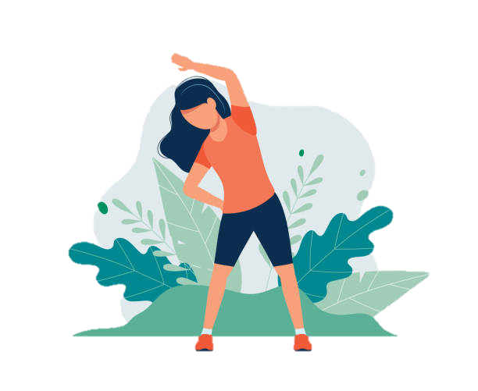
Benefits of Physical Activity
Increases dopamine levels in the brain.
Dopamine is the “gas pedal of pleasure.”
Improves the signals that tell your brain you are satisfied—satiety.
Reduces food cravings.
Reduces stress and anxiety.
Improves mood; prevents and treats depression.
Notes:
Lets focus on just one for right now, the exercise.

Slide 15

Effort Driven Rewards
Our brains are designed to have a deep sense of satisfaction and pleasure when we connect movement, thinking, and emotions.
When we work with our hands, it results in dramatic, positive changes in the brain (crafting, gardening, woodworking, sculpting, etc.).
Amish have less depression.
Notes:
Our genetic makeup of homo sapiens has not changed from the hunter gatherer state, but our lifestyles have. We still have an inate need to produce a tangible result from our physical efforts. Gardening, cooking, scuplting, etc. Videogames, iphones, cell phones ipads, etc, do not produce this.
Amish have a much lower rate of depression; its no wonder why.

Slide 16
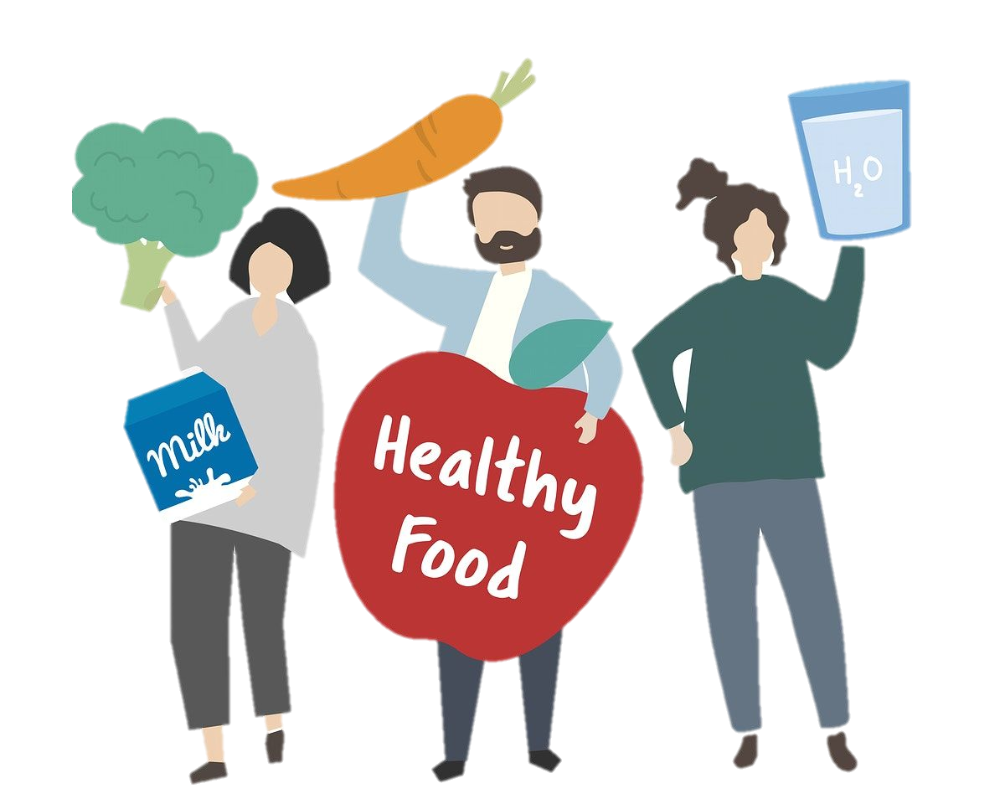
SMILES Study
Diet group reported:
  Feeling better emotionally
  Had more clarity and energy
  Feeling able to overcome barriers to healthful eating
Notes:
The SMILES trial study – Supporting the Motivation of lifestyle in Lowered Emotional States
First randomized control trial to eval diet and improvement in depressive symptoms
Mediterranean diet or Social Support in 7 sessions were given randomly to people

Slide 17
Studies
Prevention trial showed dietary counseling was as effective as mental health counseling in many adult cases.
Diets high in fruits and vegetables, whole grains, fish and olive oil, low fat dairy and antioxidants and low in other animal foods was associated with a decrease risk of depression.
Notes:
Meta-analysis is coming many different studies to find common results

Slide 18
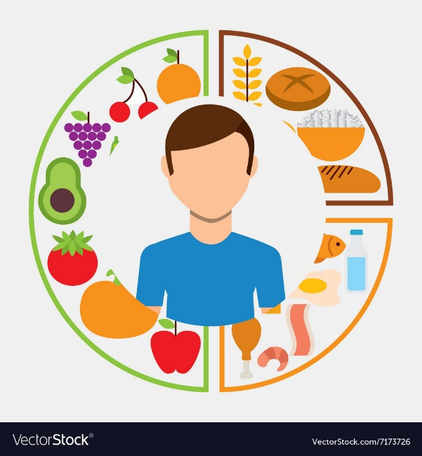
Nutrients
Diversity in diet
Nutrient deficiencies may be tied to depression.
  Vitamin D, Zinc, Mg, B12
  BS instability
Notes:
Diversity in diet is a person’s treatment for depression.

Slide 19
Nutrients
Nutrients are needed all day long; eating pattern matters to obtain optimal nutrition.

Slide 20
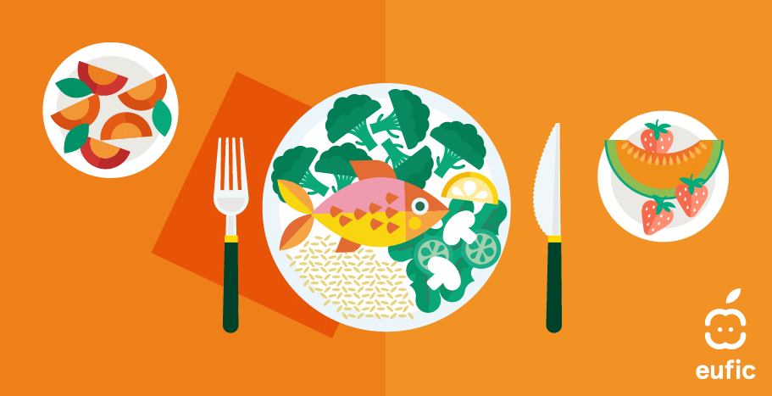
Body, Brain, and Gut Requirements
A diverse diet of plant foods is imperative.
Mediterranean diet is a default plan.
  Polyphenols and antioxidants (Folate, Zinc, Magnesium, Iron, B12)
  Fiber diversity
  Omega 3 fatty acid
Notes:
Meta-analysis demonstrated a reduced risk of depression in subjects who had a higher adherence to Mediterranean diet.
The list of nutrients have all been identified as nutrients in Mediterranean diet that feed the brain, reduce inflammation, impact oxidative stress and neurotransmitter regulation. .

Slide 21
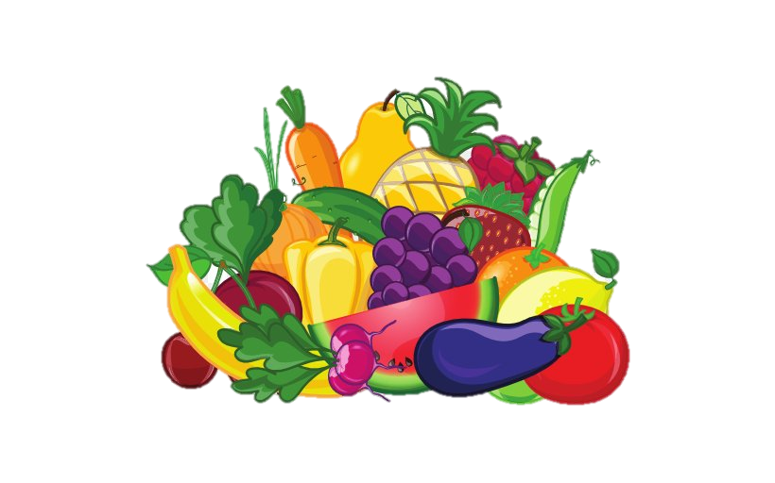
Mediterranean Diet
Eat: vegetables, fruits, nuts, seeds, legumes, potatoes, whole grains, herbs, spices, fish, seafood, and extra virgin olive oil
Eat in moderation: poultry, eggs, cheese, and yogurt
Eat rarely: red meat, sugar-sweetened beverages, added sugars, processed meat, refined grains, refined oils, and other highly processed foods
Notes:
Many studies on red meat, especially those conducted in the US, primarily examine meat from factory-farmed animals that have been fed grain-based feeds.
It’s important to make a distinction between different kinds of meat. For example, grass-fed and organic meat is nutritionally different than factory-farmed, processed meat.

Slide 22
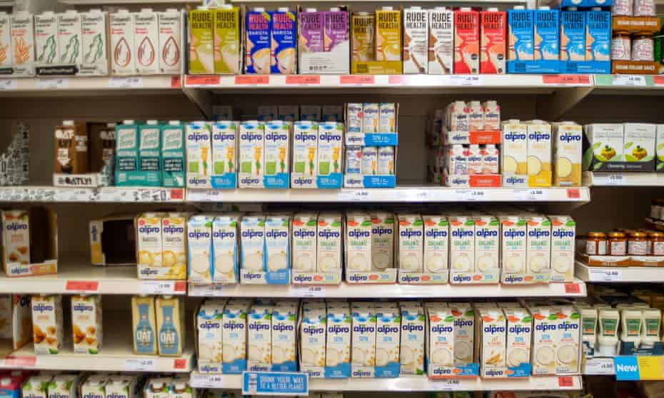
Dairy
Fermented dairy is associated with reduced instance of depression.
High fat dairy in small amounts may be beneficial to depression.
Unsweetened fermented is recommended.

Slide 23
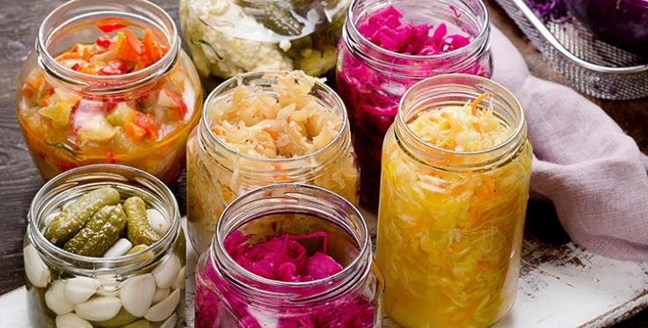
Fermented Food
When considering a healthy gut environment, fermented foods are the first and best choice.
  Yogurt
  Kimchi
  Sauerkraut
  Miso
  Kombucha
Supplemental probiotics can be used, but must vary.
Notes:
Saurkraut on salad or sandwiches
Sugar in kombucha
Yogurt unsweetened

Slide 24
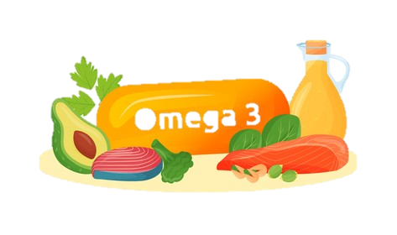
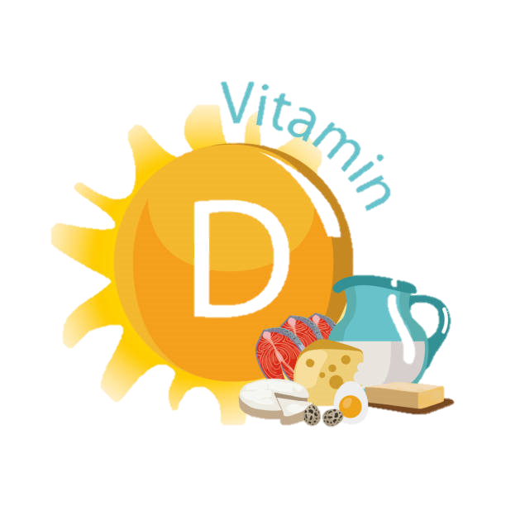
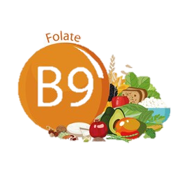
Nutrients for Mood
Omega 3 fatty acids
  2gm/d
  Choose food first
    Fatty cold water fish such as salmon, mackerel, tuna, herring, and sardines
    Nuts/seeds (flax, chia, walnuts)
Vitamin D
  Get outdoors or supplement
Folate
  Leafy green vegetables and whole grains

Slide 25
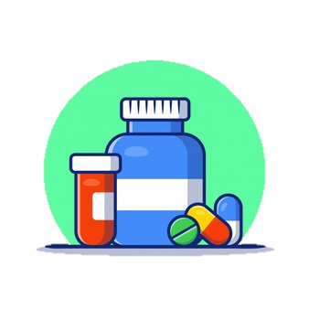
Supplements
DHA and EPA (2 gm recommended)
  Purified version is best
Omega 3 FA
  Prescription level may be an option
Vitamin D
  Serum vit D levels > 20-30 ng/dl

Slide 26
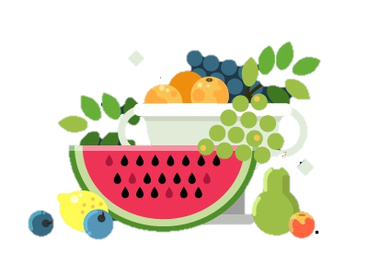
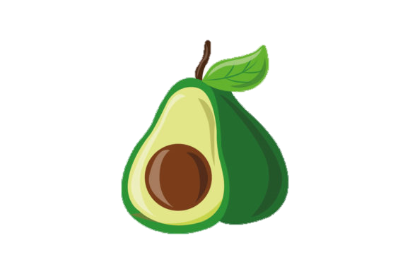
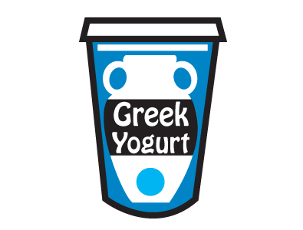
Where to Start?
Think add more instead of take away.
  Have fruit as a dessert or snack between meals.
  Add vegetables to omelets, cooked grains to create salads, roasted with potatoes, or cold sides with favorite dips.
  Add avocado to salads, eggs, toast, wraps, etc.
  Top plain Greek yogurt with raw honey, walnuts, cinnamon, and chopped apple.
  Top salads with kimchi or sauerkraut.
Notes:
When you start adding fruits vegetables and healthy fats into your diet, it makes less room for the foods that do not serve you well.

Slide 27
Please Take this Survey
Survey Link
Notes:
When you start adding fruits vegetables and healthy fats into your diet, it makes less room for the foods that do not serve you well.

Slide 28
References
Today’s Dietitian
National Institutes of Health
Food and Mood Flyer

