Slide 1
Healthy Lunches
Made Easy!
AultCare Wellness
Notes:
Survey: More than half of U.S. employees who typically eat lunch during work hours struggle to make it healthy
New survey from the American Heart Association and Aramark highlights employed Americans' desire to eat more healthfully.

Slide 2
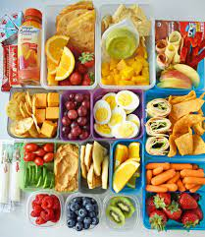
Healthy Lunches Made Easy!
Would you like to provide healthy lunches for you and your family, that are delicious, nutritious, quick, and easy?
This presentation is “packed” full of lunch time tips for busy people and their families.

Slide 3
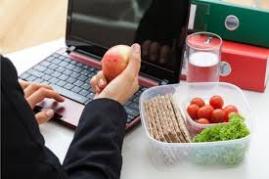
Struggling with Ideas? You’re Not Alone.
According to a survey from the American Heart Association, more than half of employed Americans who typically eat lunch during work hours struggle to eat a healthy lunch at work.
More than 75% say they’re more likely to make healthier decisions at other times of the day if they eat healthy at lunch.
Notes:
It’s lunch time. Feeling hungry but it was a hectic morning and you brought nothing to eat.
Do you find yourself grabbing high calorie, unhealthy fast food or vending snacks for lunch?
Are you going to restaurants or cafeterias for lunch hoping for a healthier meal, yet eating 3X the portion your body needs?

Slide 4
Why Not Just Skip It?
Skipping lunch may leave the body depleted of vital nutrients
Eating a balanced lunch is vital to keeping necessary hormones in balance, especially insulin which regulates blood sugar
A healthy lunch provides energy and nutrients to keep the body and brain working throughout the afternoon
Eating lunch also provides a physical and mental break from the activities of the day
Notes:
Skipping meals causes your body to lose out on , lose energy, and interrupts important pathways in the systems to complete the tasks you ask you body to do well for you everyday.

Slide 5

Not Hungry?
The body sends hunger signals when it needs food
Pay attention to your body and its hunger signals
If you are truly not feeling hungry at lunch time, pack a small, healthy snack to prevent energy from dropping later when you may not have an opportunity to eat
Be sure to adequately hydrate with water throughout the morning
Dehydration can skew hunger signals
Notes:
When you skip meals regularly, your body gets used to that pattern and hunger signals may go unnoticed.
People drink to many dehydrating beverages in the morning and not enough water. (coffee, tea, caffeinated soda). This can lead the body to think its always hungry when actually it needs fluid.
For most, lunch does not need to be a large meal, especially if sedentary most of the day.
Eating a well balanced lunch or small mid day healthy snack can help avoid unhealthy cravings for high carbohydrate foods or energy boosting caffeine drinks later in the day.
A lunch too large, and one high in processed foods and carbohydrates, may make lead to a drop in energy.

Slide 6
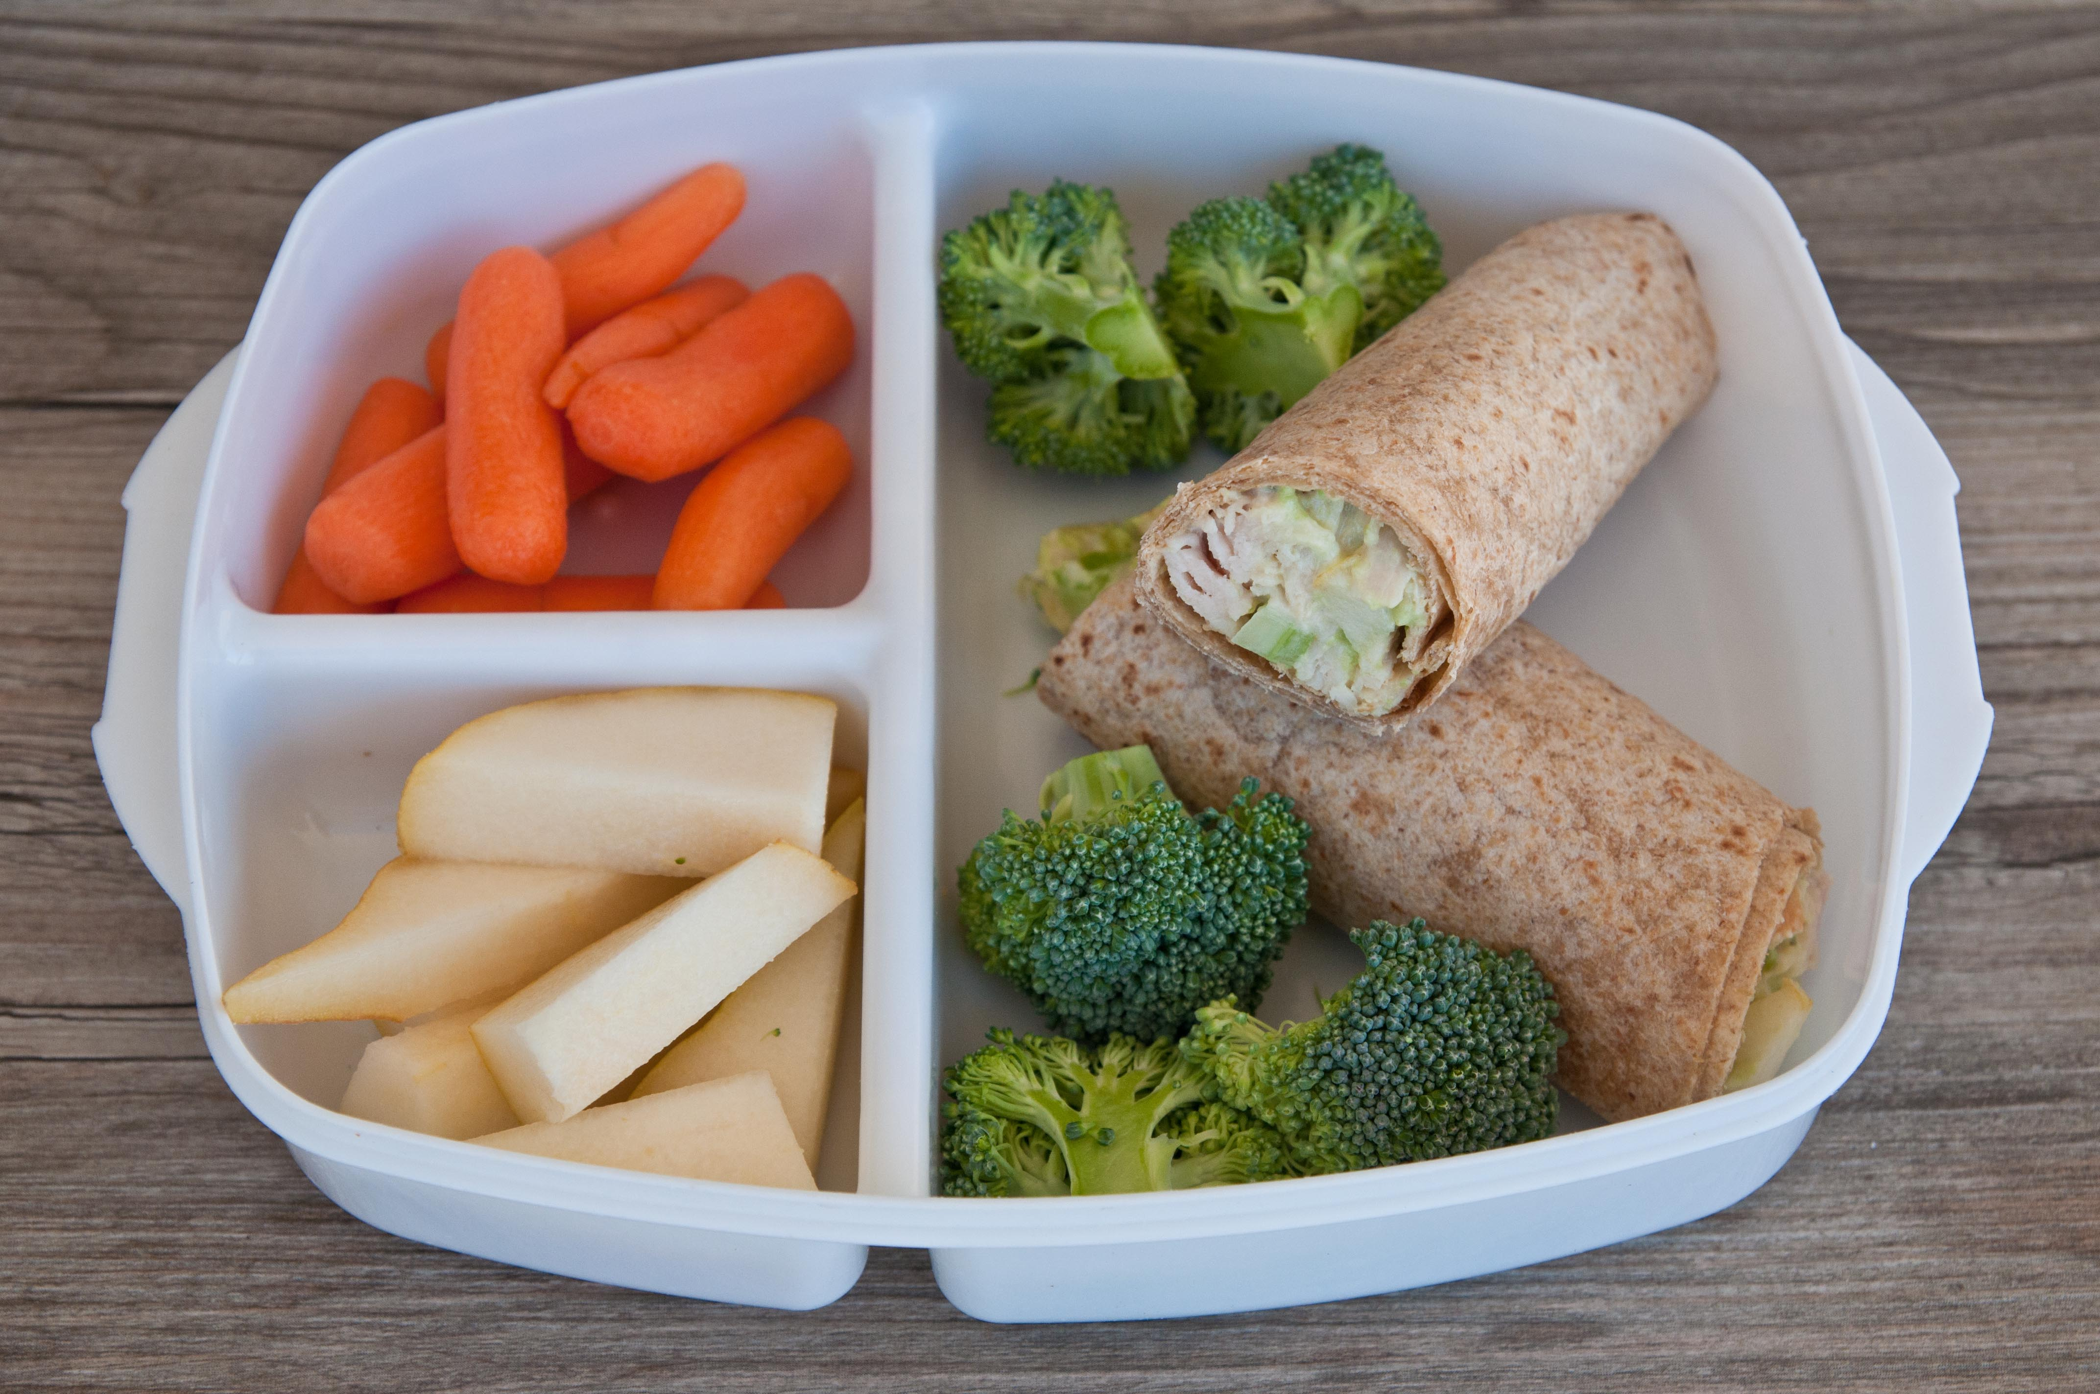
Pack Your Lunch
By packing your lunch, you are in control
You can make conscious and well thought choices
This not only saves time, but saves money
Packing your lunch controls:
  Calories
  Sugar
  Sodium
  Fat
  Additives and preservatives

Slide 7
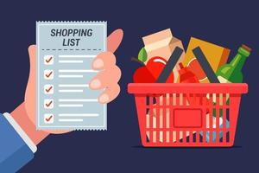
Start at the Grocery Store
Make a list to last for the week
Buy items for easy packing
Keep it simple
Precut, prewashed and ready to eat fruit and veggies
Single serving bags
Yogurt, string cheese, pre-cooked chicken, cottage cheese singles, tuna singles
100% whole wheat breads, pitas, wraps and, thins
Pre-cooked quinoa and rice bowls
Canned beans and cooked lentils
Premade salad kits

Slide 8
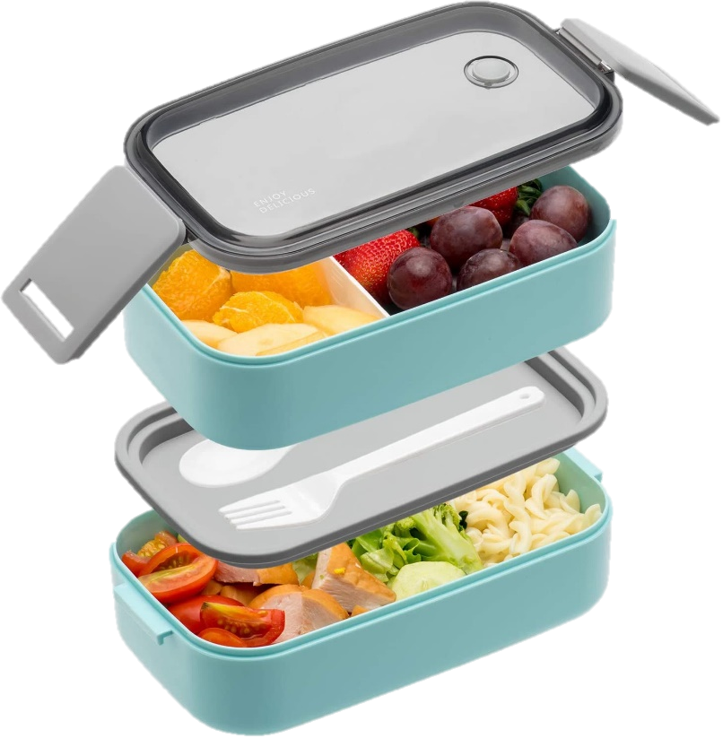
Purchase a Bento Box
It makes packing fun
Use the bento box to balance your lunch
Be sure to include as many fruits and veggies as you like
Notes:
For less than $10.00 you can purchase one. My Plate includes ½ fruit and vegetables, ¼ protein, ¼ starch and a small serving of healthy fat.

Slide 9
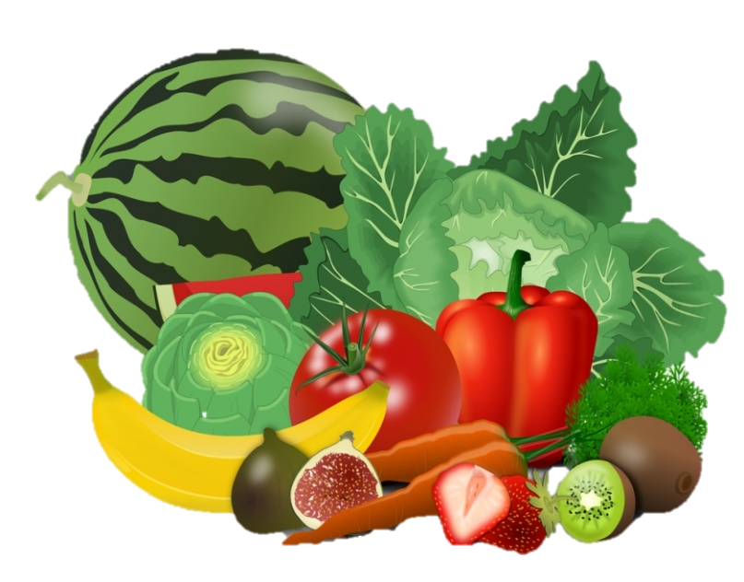
Fruits/Vegetables
Bento Box Ideas
  Snap peas
  Carrots
  Parsnips
  Radishes
  Cucumber slices
  Melon pieces
  Citrus slices
  Berries
Salad Ideas
Mixed Greens topped with
Black beans/corn/salsa
Artichokes, sundried tomatoes, and broccoli
Hummus, sunflower seeds, cucumbers, and tomatoes
Goat cheese, beets, walnuts

Slide 10
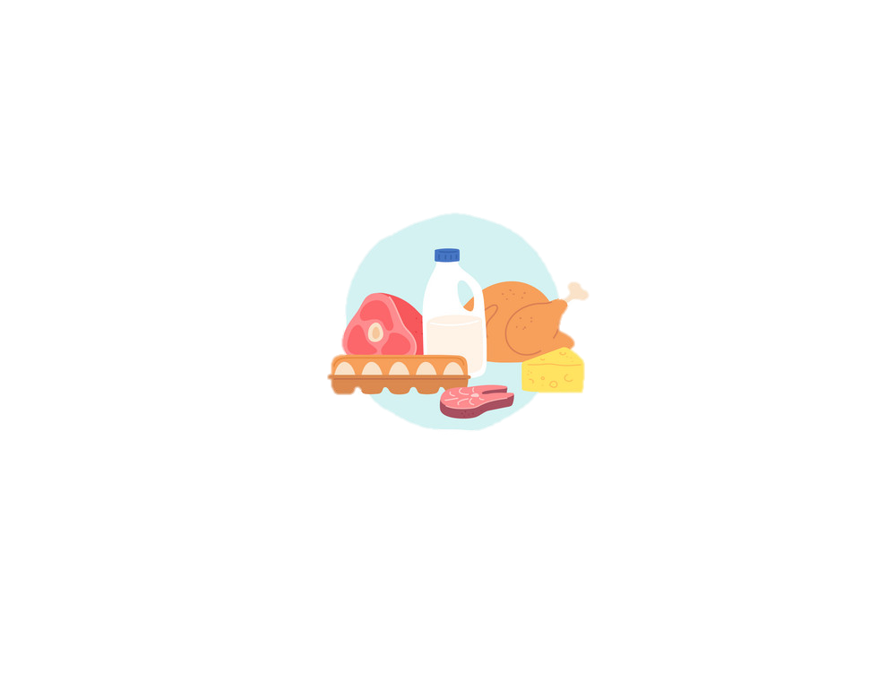
Think Protein
Rotisserie chicken
Leftover meat
Cheese
Nuts
Tuna
Chick peas (any canned bean)
Hard boiled/deviled eggs
Natural jerky
Yogurt
Quinoa
Lentils

Slide 11
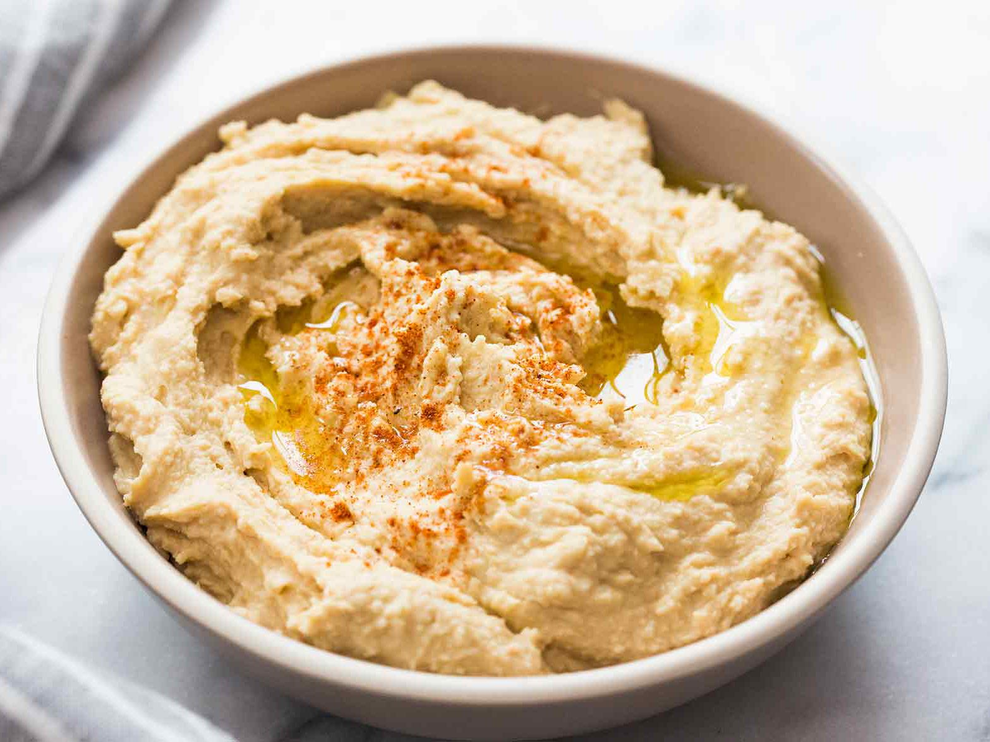
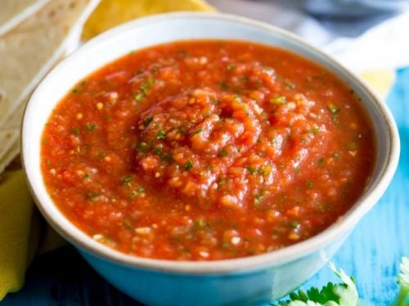
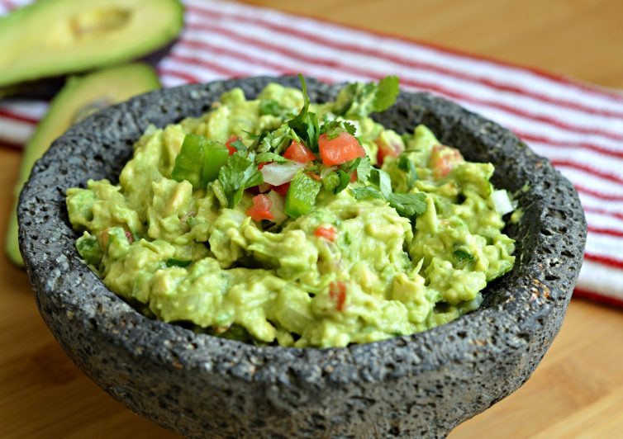
Healthy Fats/Tasty Toppings
Guacamole
Buffalo sauce
Yogurt ranch
Salsa
Spicy mustard
Hummus
Vinaigrette
Citrus and oil
Sliced avocado

Slide 12
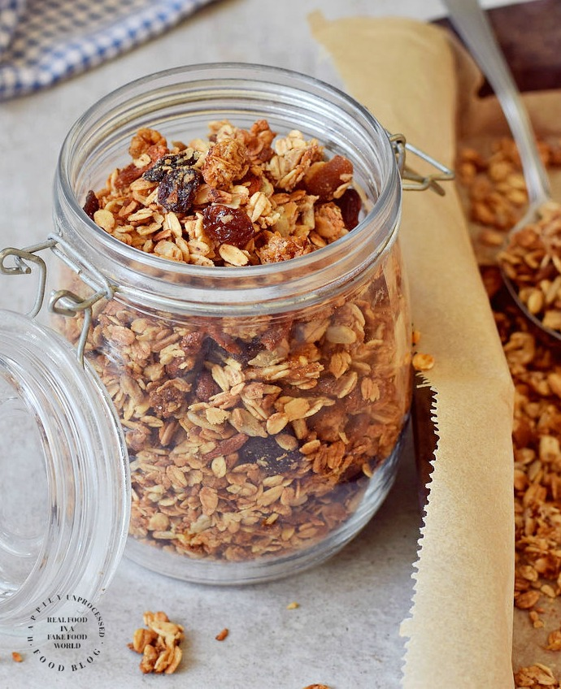
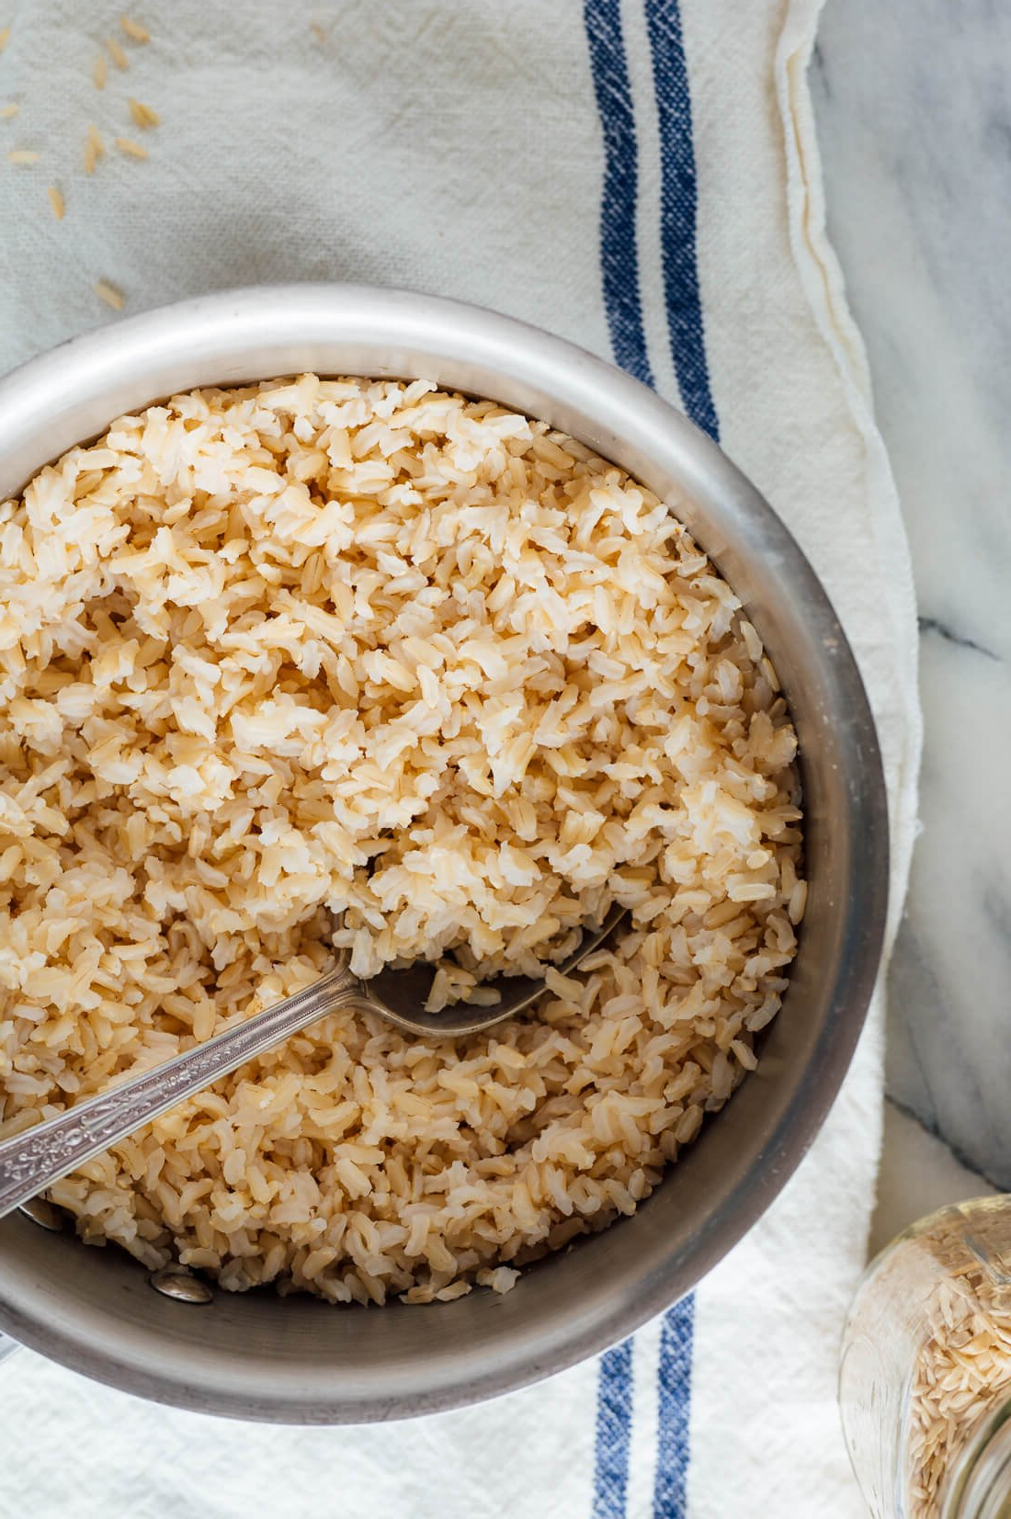
Starch
Nut thin crackers
Whole grain/low carb wraps
Dried beans/lentils
Brown rice or wild rice
Granola
Cooked ancient grain (quinoa, millet, farro)
Sweet or white potatoes, yams, winter squash
Cooked brown rice noodles
Rice cakes

Slide 13
Make it a Combo Meal
Whole grain chicken wrap with cheese, pepper slices, and lettuce
  Add an apple
Left over quinoa or brown rice makes a salad by adding chopped veggies (tomato, cucumber, broccoli, cauliflower) and topping with dressing
Pasta salad made with rice noodles, broccoli, and peanuts
  Top with Asian-ish peanut sauce
  Add a protein
  Skip the peanut theme and add fresh squeezed citrus, olive oil, goat cheese, and fresh cilantro or basil

Slide 14
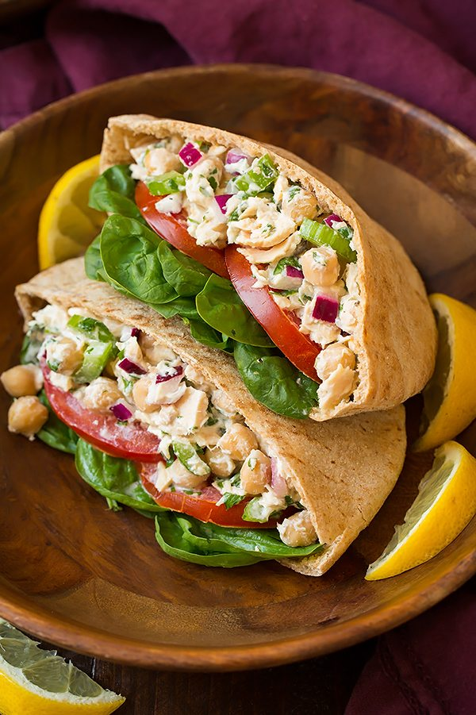
And More…
Make more at dinner and eat the leftovers!
Tuna or egg salad sandwich with pita topped with lettuce, onion, and tomato
  Cut down on carbs and use as a dip for veggies or lay on bed of lettuce topped with more veggies
  Add a sweet peach for dessert!
Build a bowl
  Layer protein, grain and vegetables, top with a dressing or sauce

Slide 15
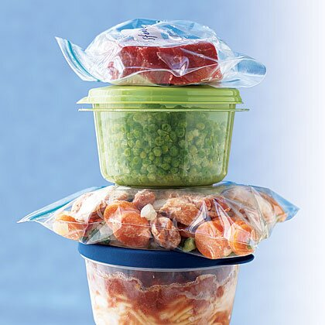
Leftovers
Most of us cook a well-balanced dinner with meat, starch, and vegetable for dinner
Cook extra for lunch the next day!
  Put it in your bento box or container as you are cleaning up after dinner and it is ready to grab in the morning
If you don’t have quite enough, add a can or frozen veggies
Notes:
If your grilling or baking dinner, why not add a few more to offer yourself a wholesome lunch for tomorrow. Generally the foods we cook for dinner make the most nourishing lunches; far better than a lunch meat sandwich!

Slide 16
Healthy Avocado Tuna Salad Recipe
5 oz. can tuna drained
1 avocado roughly chopped
1/2 cup cucumber chopped
1/4 cup minced celery
1/4 cup minced red or green onion
2 tbsp chopped fresh cilantro or parsley
1 tbsp olive oil
1 tbsp lemon juice
Place all ingredients in a bowl and mix with a fork
Use salt and pepper to taste
Notes:
Dislike avocado? Switch it out for olive oil mayo and omit the olive oil and lemon juice.

Slide 17
Healthy Pasta Salad Recipe
1 box whole grain pasta (whole wheat, spelt, or brown rice pasta) cooked and cooled
½ head fresh broccoli chopped
1 container cherry tomatoes
1 small cucumber peeled and chopped
½ small red onion sliced thin
1/3 cup garlic sensations dressing
Mix all ingredients in a bowl
Allow to marinate ½ hour and serve
Use less pasta, more veggies to lower calories and carbohydrates
Notes:
Don’t have enough for a full salad? Make it individual. Use the vegetables available in your refrigerator, it doesn’t have to match the recipe

Slide 18
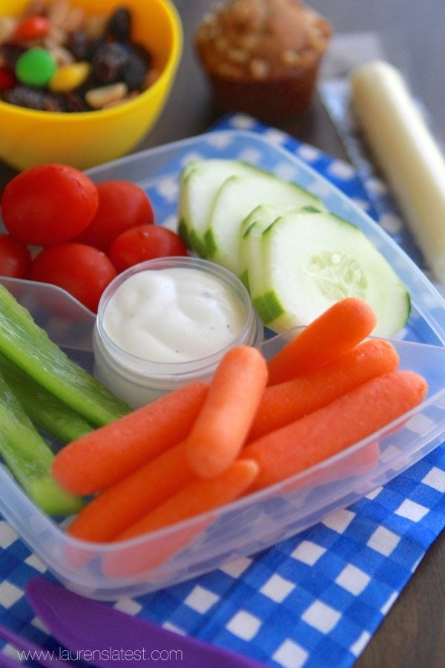
Ala Carte Lunch Ideas
2 hard boiled eggs, carrots/ranch, apple with peanut butter
Canned Cannelli beans, tuna, chopped celery, onion, and carrot with dressing
String cheese, rice crackers, and cutie oranges
Hummus, veggies, pita chips, and cottage cheese
Eat all the fruits and veggies you want, but don’t forget protein

Slide 19
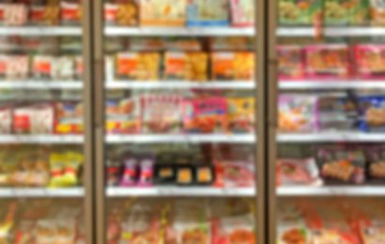
Frozen Lunches
Can be a good choice; but there are no guarantees!
Be sure it has less than 15 grams of fat and less than 800 mg of sodium
Look for whole grain options and minimal ingredients
Complete the meal with vegetables and fresh fruit if needed
Notes:
Not just any frozen meal will due. Generally the cheaper the cost, the poorer the ingredients.
If you are on a low sodium diet, use frozen meals as a last resort.
Remember if the total calories are lower than the sodium, the food is considered a high sodium food!

Slide 20
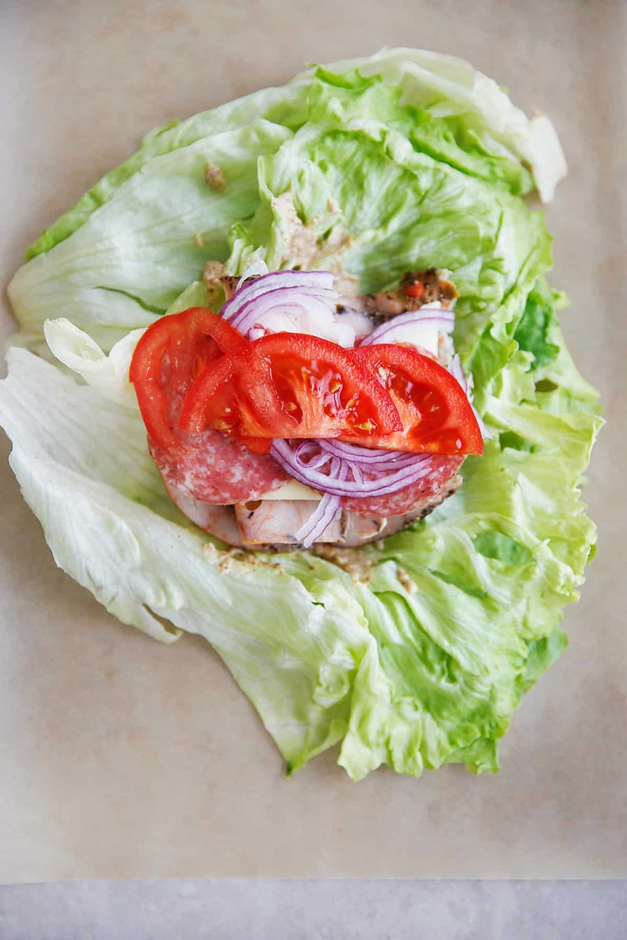
Eat This, Not That
Make a sandwich with a lettuce wrap (skip the bread)
Fresh vegetables, whole grain, or rice crackers if you need a crunch (skip the chips)
Eat more grilled or baked dinner leftover meat or seafood (skip the deli meats)
Try a baked potato topped with vegetables or salsa, bake ahead of time and reheat at lunch (skip the fries)
Notes:
Be Careful: Veggies Chips are not better! They are still fried in canola oil and layered with salt

Slide 21
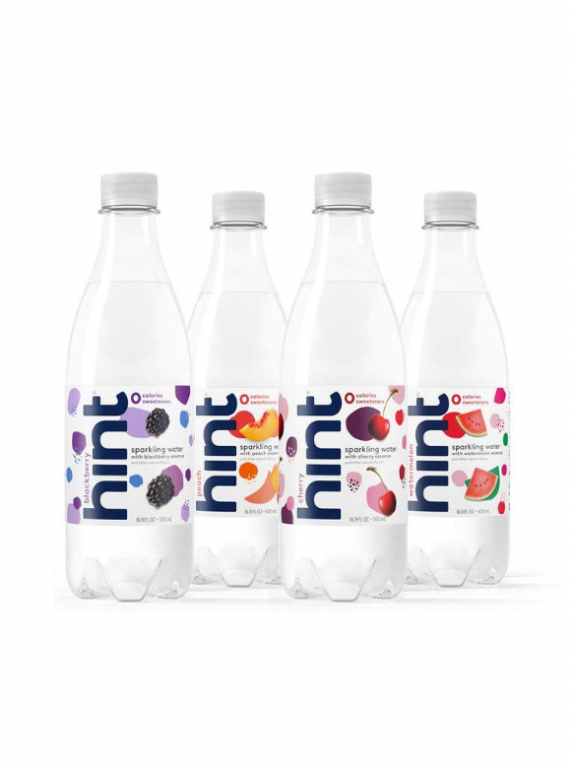
Drink This, Not That
Water
Unsweetened flavored water (instead of soda or energy drinks)
Unsweetened tea (instead of sweet tea)
Low-fat milk and milk alternatives (instead of coffee drinks or milkshakes)

Slide 22
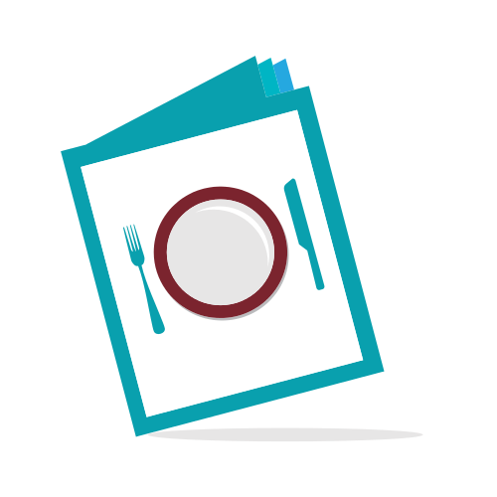
Going to a Restaurant?
Look at menu and plan ahead
  Your favorite protein over greens is likely a good choice
  You can ask for dressing on the side, no croutons, dried fruits, or bacon
  Light on the cheese, please
  Don’t clean your plate
  Restaurant servings are often 3X larger than recommended serving sizes
  Eat ½ of what is served and take the other ½ home
  Broth soups, not cream
Notes:
Balance: look on the menu for options that offer veggies and less starch. Ask for substitutions. Pasta on the side rather than a full meal. Opt for a protein, vegetable balance.

Slide 23
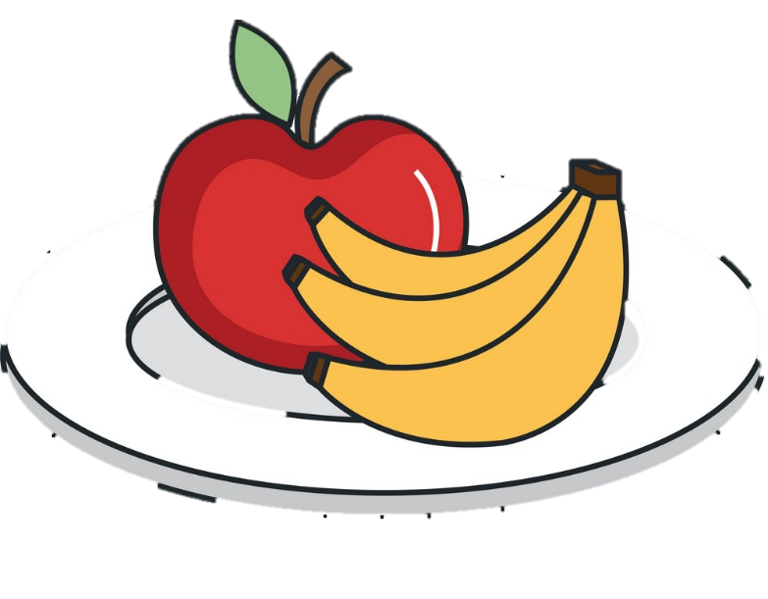
Snack Only When Hungry
Pick nature’s fast foods which come conveniently packaged, sized, and ready to go
  Bagged carrots or snap peas
  Apple, banana, pear, peach, or fruit leather
  Kashi, Lara, Kind, RX bars
  Nuts, seeds
  Plain yogurt
Notes:
Hungry when you get home from work? Ready to raid the cupboards or eat a small child? You may need an afternoon snack. Snacking is a smart way to stay on track with good eating habits. Choose nutritious filled snacks rather than empty calories.

Slide 24
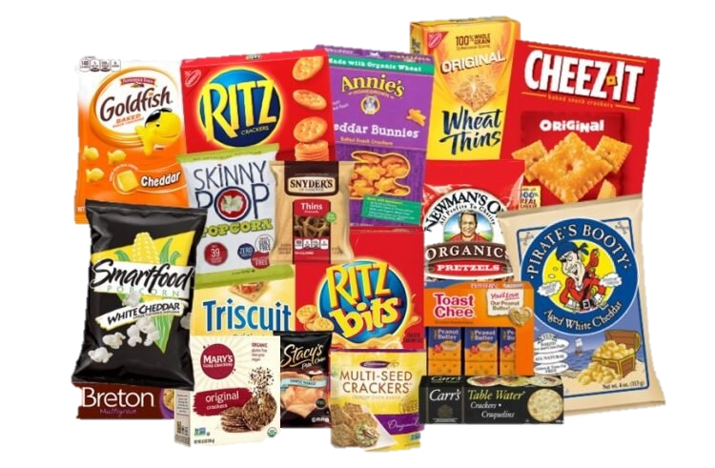
Snacks We Think Are Good
Greek yogurt (20 GM SUGAR!!)
Granola bars (MORE SUGAR!!)
Pretzels (cardboard has the same nutrition)
Prepackaged peanut butter or cheese crackers
Goldfish, Cheez Its, 100 cal snacks
Fruit snacks
Lunchables/Uncrustables

Slide 25
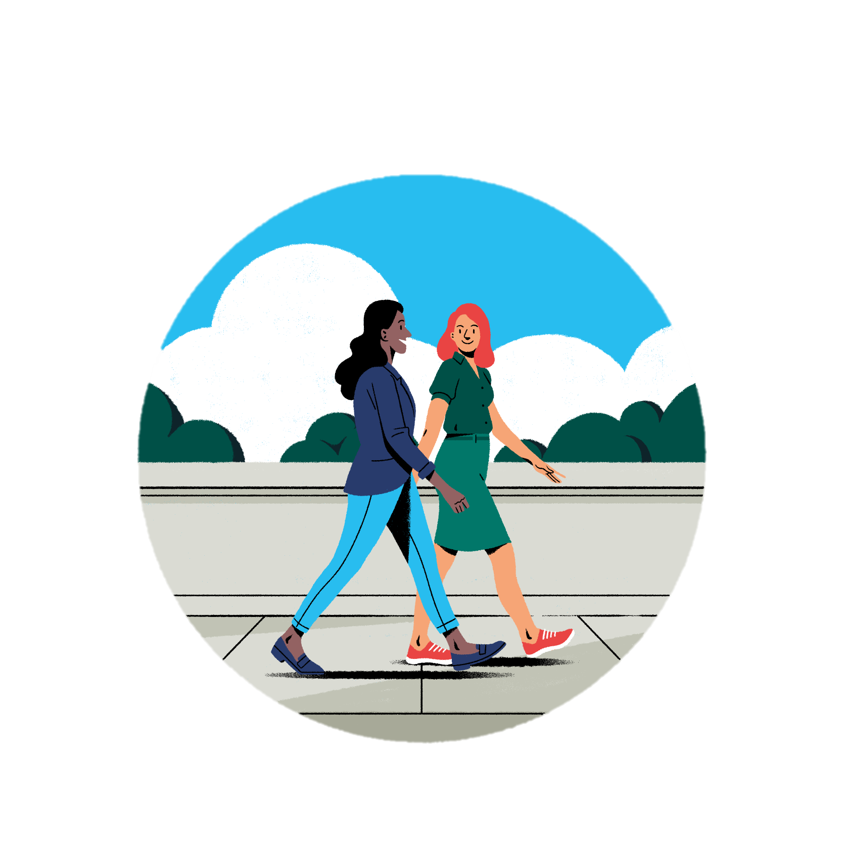
Extra Time During Your Lunch Break
Packing your lunch may give you extra time during your lunch break
Use ½ the time to eat and walk the other ½
This will enhance circulation, making you feel more alert and relieve stress
  Clarity of mind
  Clears out the cortisol (stress hormone)
  Endorphins to feel good
  Burns calories
Notes:
Exercising at lunch MAY BE YOUR only options. Don’t’ scrunch your nose up. Use the time wisely. If you get it done at work, you all have all your free time at home.
Brainstorm, is there a place outside, how about inside? Can you drive to another location in 5 minutes? Planning ahead and enlist a co-worker to keep you on track
Exercising at work releases endorphins to make you feel better about yourself, and the work you do.

Slide 26
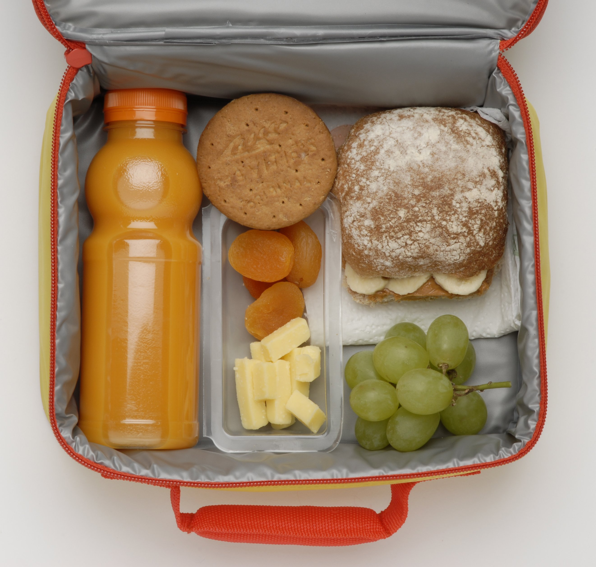
Conclusion
Proper nutrition promotes good health and helps prevent chronic disease
A healthy lunch can keep you and your family functioning at your best during work and school
It is quick and easy
Packing lunch can save time and money!

Slide 27
Sources
American Heart Association
Academy of Nutrition and Dietetics
www.eatright.org

