Slide 1

Headaches and
Migraines
AultCare Wellness

Slide 2
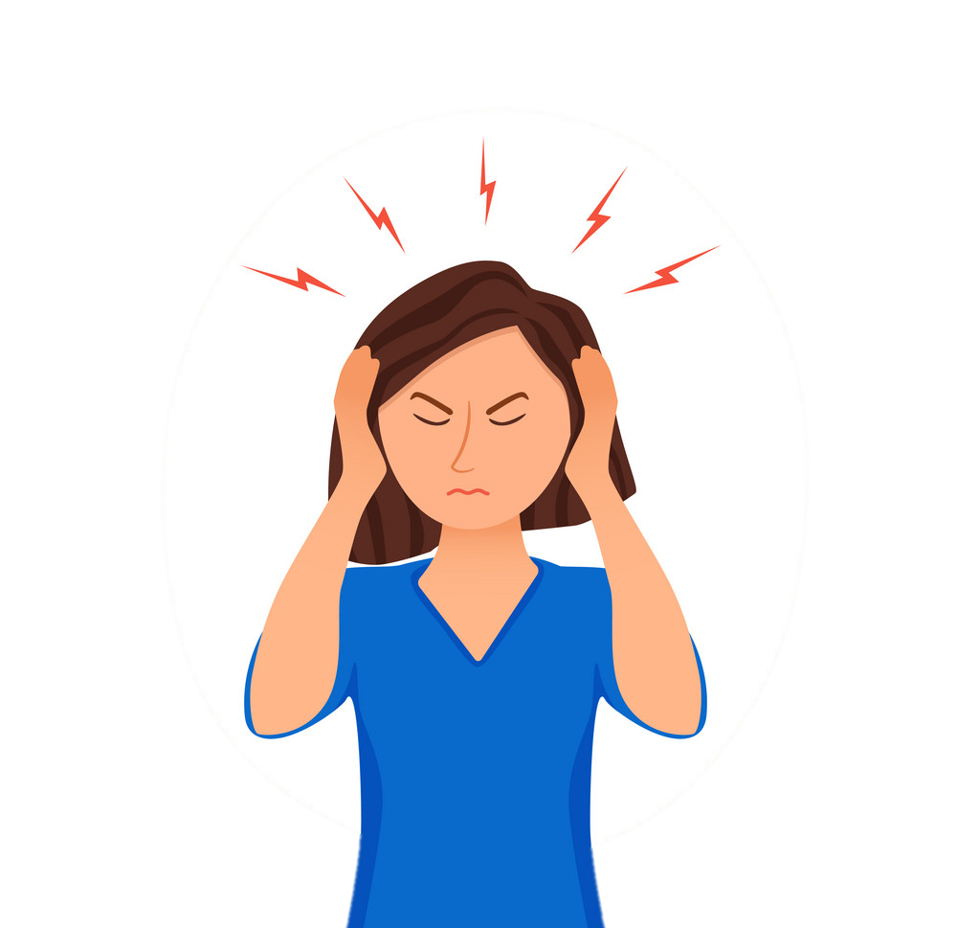
Migraine
Migraine is an extraordinarily prevalent neurological disease, affecting 39 million men, women and children in the U.S. and 1 billion worldwide.
Nearly 1 in 4 U.S. households includes someone with migraines.
Migraines are most common between the ages of 18 and 44.
Migraines tend to run in families. About 90% of migraine sufferers have a family history of migraines.

Slide 3
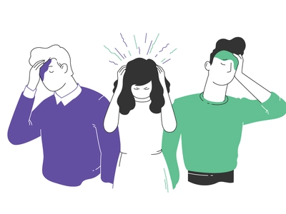
Types of Headache
Tension headaches – Eyestrain, stress and hunger are frequently causes of tension headaches, can be chronic
Sinus headaches – Caused by swelling in the sinus passages, resulting in pain behind the cheeks, nose, and eyes
Cluster headaches – Can be caused by physical exertion, bright lights, or even altitude
Notes:
Tension: The pain from tension headaches tends to spread across both sides of the head, often starting at the back and creeping forward. This is the most common form of headache pain. Eyestrain, stress and hunger are frequently causes of tension headaches, and they can be chronic.
Sinus: These headaches often strike when you’re sick or feeling congested. They’re caused by swelling in the sinus passages, resulting in pain behind the cheeks, nose and eyes. The pain is often as its worst when you wake up on the morning and when you bend forward.
Cluster: These headaches are usually very painful and occur in “clusters,” meaning they happen daily (usually at the same time), sometimes up to several times per day for months. They are a result of dilation in the blood vessels of the brain due to a release of serotonin and histamines. They can be caused by physical exertion, bright lights or even altitude.

Slide 4
Migraines
Migraines are a neurological disease that involve nerve pathways and chemicals.
Changes in the brainstem and its interactions with the trigeminal nerve, a major pain pathway, might be involved.
So might be imbalances in brain chemicals — including serotonin, which helps regulate pain in your nervous system.
Notes:
When most people hear the term migraine, they often think of a severe headache. But headaches are only one symptom of migraines, and they can range in severity and length.

Slide 5
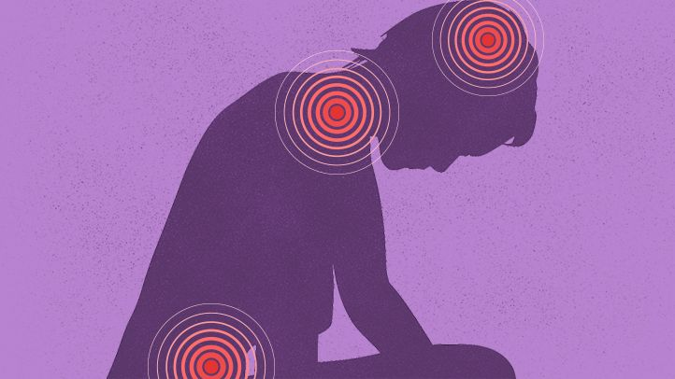
Migraines continued
In addition to severe head pain, migraine sufferers may experience some or all of the following symptoms:
Nausea
Increased sensitivity to light, sound, or smells
Dizziness
Extreme fatigue

Slide 6
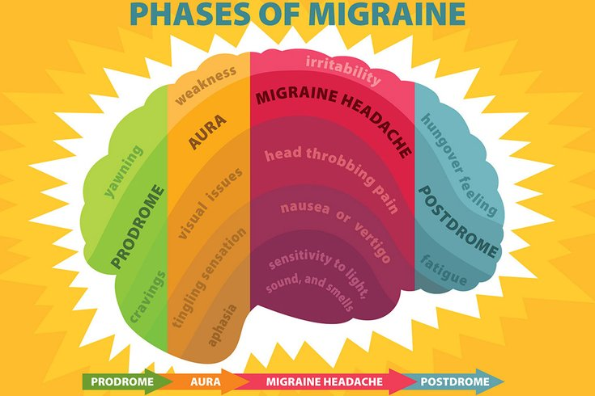
4 Different Phases
Prodrome phase: Pre-headache phase
Aura phase: Sensory disturbances that occur before or during a migraine
Headache phase: This is when the pain usually hits
Postdromal phase: The final phase is when the pain has subsided
Notes:
Prodrome: This stage features painless symptoms that occur hours or days before the migraine arrives. These include mood swings, food cravings and stiffness of the neck.
Aura: Auras can affect a person’s vision, touch or speech, though not everyone who suffers from migraines experiences auras. Examples of auras include blurred visions, blind spots that expand over time, numbness in the arm, and slurred or jumbled speech.
Headache phase: may range from mild to debilitating. Physical activity and exposure to light, sound and smells may worsen the pain. However, some people can have a migraine without developing a headache.
Postdromal phase: People may feel exhausted, confused or generally unwell during this phase.

Slide 7
Migraine Causes
Migraines have common triggers but no one cause, unlike headaches
Gender and hormonal shifts
Allergies
Family history and genetics
Environmental
  Drinks, physical factors, medications, foods, food additives, stress
Notes:
Gender and hormone; Women are three times more likely to suffer from migraines than men.
Hormonal medications, such as oral contraceptives and hormone replacement therapy, also can worsen migraines. Some women, however, find their migraines occurring less often when taking these medications.
Allergies: Also called allergic rhinitis, allergies cause irritation and inflammation in the body. Because migraines are associated with inflammation of the blood vessels, allergies are a known trigger for some people.
Family hx and genetics: People with family members suffering from migraines are more likely to develop migraines themselves. Scientists have discovered a genetic mutation that is common in those with the most typical type of migraine.
Enviromental: This category includes a wide range of triggers, like changes in weather, stress, food, smells and lack of sleep.
Drinks: These include alcohol, especially wine, and too much caffeine, such as coffee.
Physical factors: Intense physical exertion, including sexual activity, might provoke migraines.
Medications: Oral contraceptives and vasodilators, such as nitroglycerin, can aggravate migraines.
Foods: Aged cheeses and salty and processed foods might trigger migraines. So might skipping meals or fasting.
Food additives; These include the sweetener aspartame and the preservative monosodium glutamate (MSG), found in many foods.

Slide 8
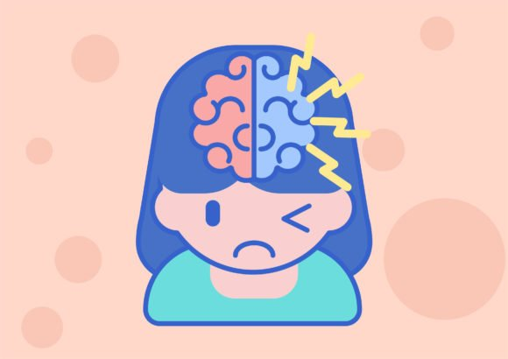
Diagnosis
Seeing a neurologist (someone specialized in headaches/migraines) may diagnose according to:
  Medical history
  Family history
  Symptoms
  Physical and neurological examination
If your condition is unusual, complex or suddenly becomes severe, tests to rule out other causes for your pain might include an MRI or CT scan

Slide 9
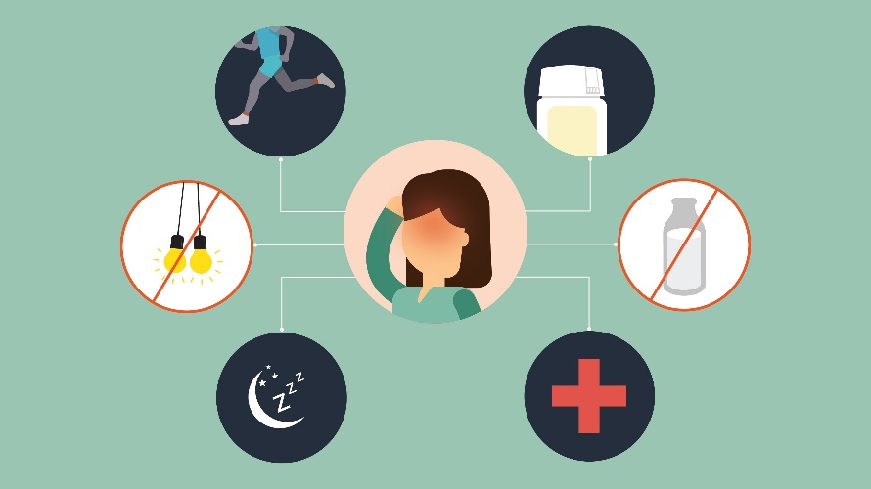
Treatment
Over-the-counter medications
Prescription medications
Preventive medications
Lifestyle changes
Speak with doctor about which treatment/medication is best for you
Notes:
OTC: acetaminophen, ibuprofen and aspirin can be helpful for headaches
Melatonin: A 2017 study also found that melatonin may help prevent migraines and cluster headaches. Since the right dose varies according to each condition and person, speak to your physician about using this treatment.
Lifestyle changes: Exercise, dietary changes, sleep, relaxation techniques like yoga and meditation
Keep a headache journal including time of day, type and location of pain, foods you ate, activity, stress level etc.

Slide 10
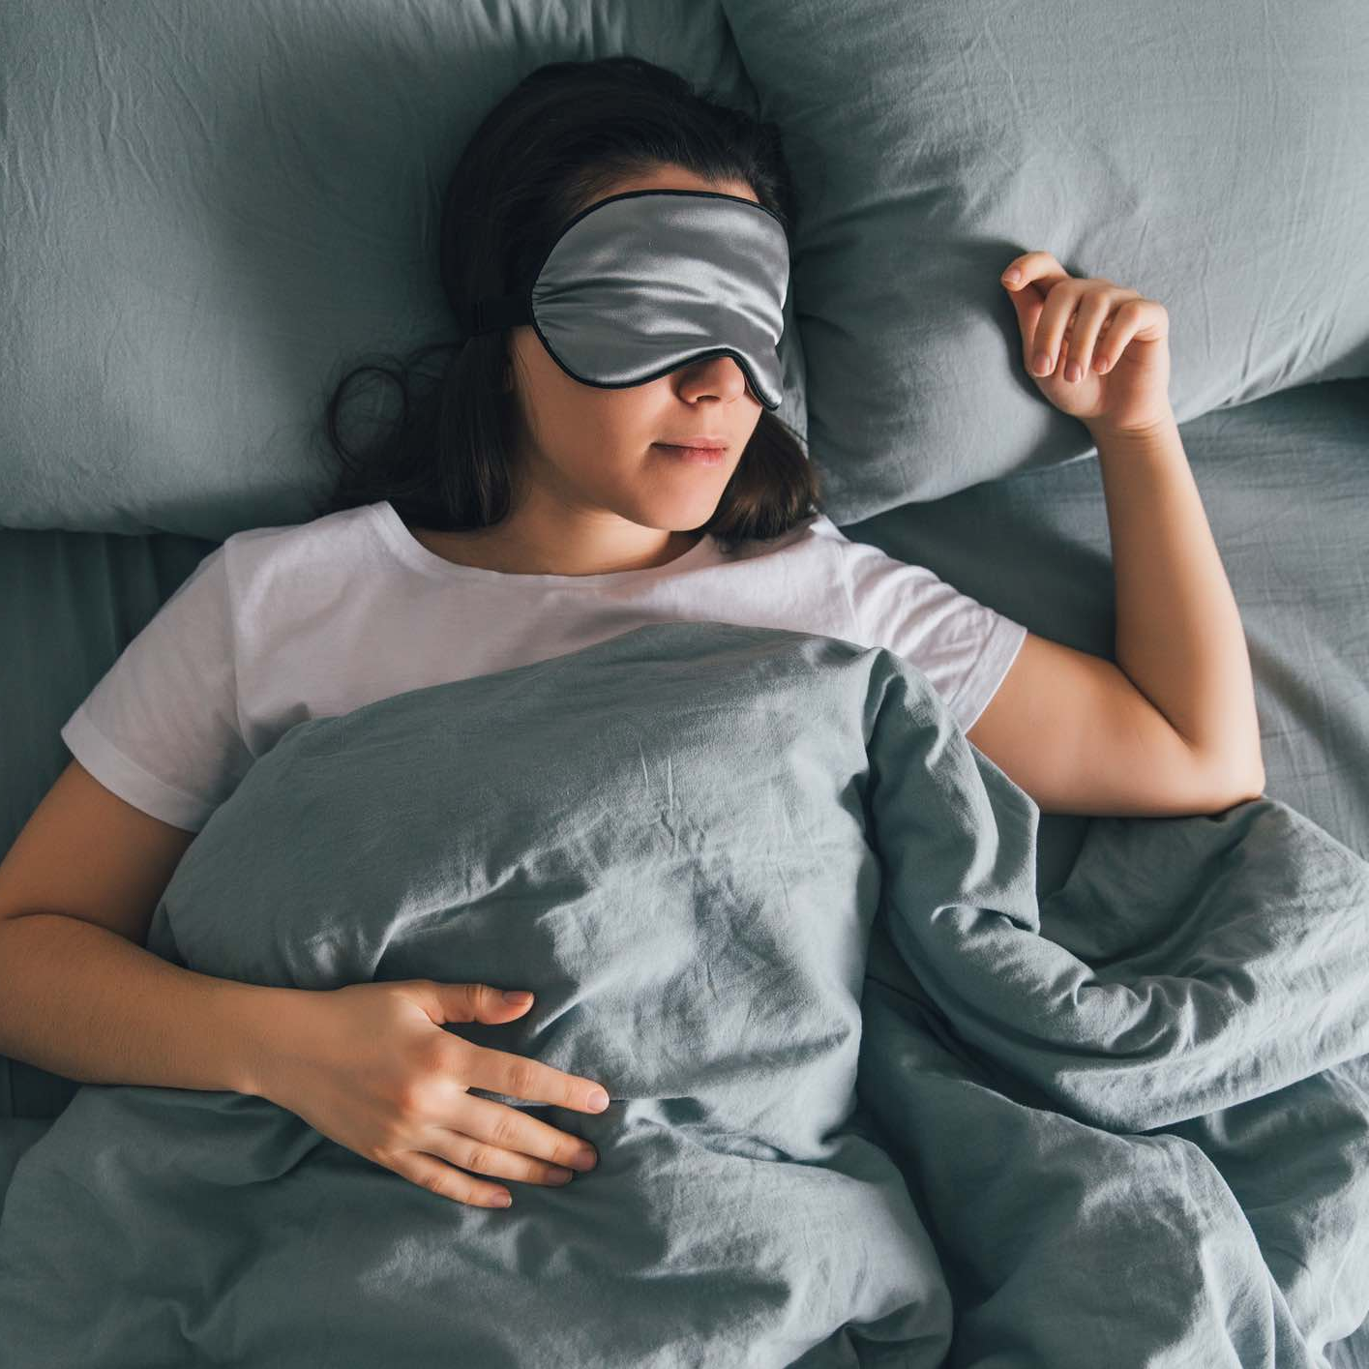
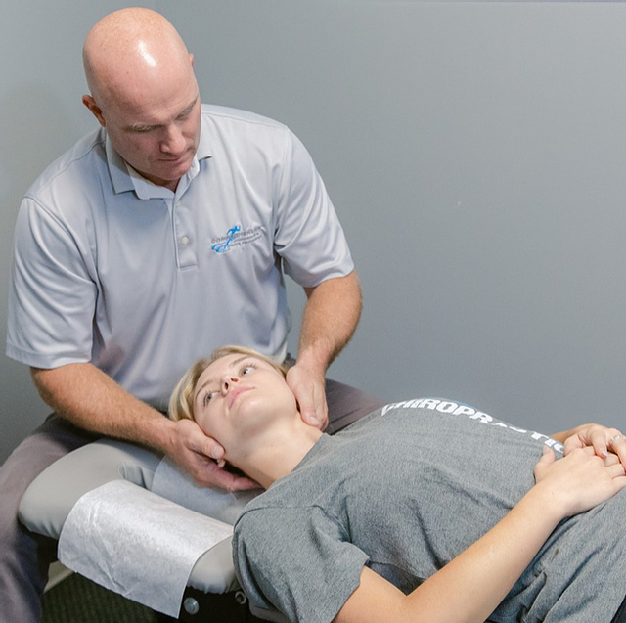

Complementary and Alternative Medicine
Acupuncture
Chiropractic care
Massage therapy
Meditation (can reduce pain)
Yoga (relaxation, reduces sleep issues and anxiety/stress)
Heat/cold
Resting/sleep
Notes:
Sleep: Research has long established a relationship between sleeping problems and headache disorders, including migraines, tension-type headache, and the less common cluster headache and hypnic headache.
However, those who experience migraines in particular are more likely to suffer from insufficient sleep than those with other headache disorders. In addition to increasing the risk for migraines, sleep deprivation has also been shown to increase the severity and frequency of migraines.
Research has found that not only too little sleep (sleep deprivation), but also too much sleep¹¹ (hypersomnia) can trigger migraines.

Slide 11


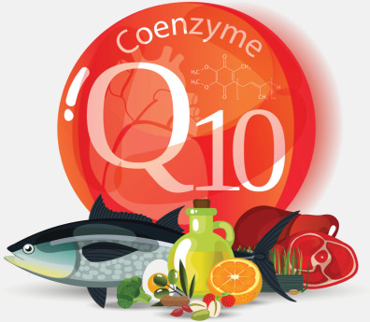

Natural Supplements
Magnesium
Feverfew
Riboflavin (Vit B2)
Coenzyme Q10
Ginger
Melatonin
Notes:
Melatonin: Widely used as a sleep aid. Sleep is natures way of dealing with a migraine.
Low levels of melatonin have been linked to migraines and cluster headaches, as well as waking up with headaches.

Slide 12
Complications
Medication-overuse headaches occur when medications stop relieving pain and begin to cause headaches
You then use more pain medication, which continues the cycle

Slide 13
Complications continued
See your doctor immediately or go to the emergency room if you have any of the following signs and symptoms, which could indicate a more serious medical problem:
An abrupt, severe headache like a thunderclap
Headache with fever, stiff neck, mental confusion, seizures, double vision, weakness, numbness, or trouble speaking
Headache after a head injury, especially if the headache worsens
A chronic headache that is worse after coughing, exertion, straining, or a sudden movement
New headache pain after age 50

Slide 14
In Summary
Migraines, most of the time, do not have a known cause
Eat a well balanced diet
Exercise regularly
Stay hydrated
Get plenty of rest
Find ways to reduce stress/anxiety
Keep a migraine journal including foods eaten
Talk with your doctor about seeing a headache specialist
Do not start taking new supplements without consulting your doctor first

Slide 15
Sources
https://www.mayoclinic.org
https://www.sleepfoundation.org
National Headache Foundation/Headache.org
AultCare fliers:
Talk to your Doctor about Migraines
Sleep Habits and Migraines
Migraine Causes and Treatments
How to support someone with Migraines
Meal Planning with Migraines in mind

Slide 16
Survey
Please click to take the Survey

