Slide 1

Digital Detox
AultCare Wellness

Slide 2
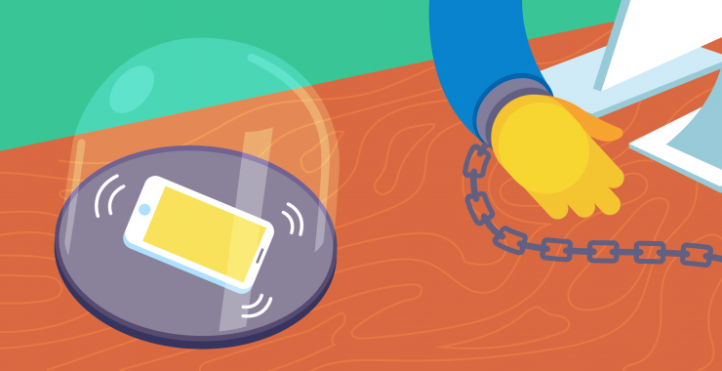
Being Too Plugged In
On average, Americans spend as much as 4 hours watching TV and about 7 1/2 hours on digital devices
Average number of times you touch
  your phone per day = 2,617
Only 35% of American adults owned
  a smartphone in 2011
  In 2019, that shot up to 81%

Slide 3
The Effects
Research shows the more time you spend in front of a screen (phone, TV, tablet, computer, gaming device, etc.) the higher the risk for:
Increased stress and anxiety
Increased feelings of depression
Poor sleep quality
Headaches and migraines
Vision problems
Loneliness/isolation
Lack of exercise
Overweight/obesity
Poor food choices
Poor self image with constant comparison of others
Poor face-to-face communication/interaction (especially in adolescents)
Diabetes
Heart disease
Certain types of cancer
Notes:
-Stress and anxiety and depression- too much time seeing other people’s unrealistic everyday perfectness, new outlets (doom and gloom), online gambling
-Depression: The constant connectivity may actually be making us feel disconnected
Loneliness has to do with more connected intimate relationships that feel real and close, and screens don’t really provide that
In a 2019 study, Michigan State researchers found adults who used social media were less likely to experience psychosocial distress, which is a hallmark of major depression and anxiety.
Poor sleep: One study shows that the use of screens before going to bed can disrupt sleep cycles, in part by suppressing melatonin.
The use of artificial lighting and electronics at night may contribute to sleep problems. These devices emit light of a blue wavelength, which may trick your brain into thinking it’s daytime
Many studies suggest that blue light in the evening disrupts your brain’s natural sleep-wake cycles, which are crucial for optimal health
***All of these are interrelated as sleep affects the whole body and depression. Depression can cause overeating, which can lead to obesity which can lead to heart disease, diabetes…etc…..Lack of exercise to increase risk of cancer, obesity, depression etc…..

Slide 4

What is the Blue Light?
Your body has an internal clock that regulates your circadian rhythm
Most importantly, it determines when your body is primed
  for being awake or asleep
However, your circadian rhythm needs signals from
  the external environment
Blue-wavelength light stimulates sensors in your
  eyes to send signals to your brain’s internal clock
Getting blue light, especially from the sun, in the daytime
  helps you stay alert while improving performance and mood
Blue light therapy devices
Notes:
Circadian rhythm:— the 24-hour biological cycle that influences many internal functions
Signal from external environment:— most importantly daylight and darkness — to adjust itself.
Blue light therapy devices: may help treat depression, and blue light bulbs have been shown to reduce fatigue and improve the mood, performance, and sleep of office workers

Slide 5
Blue Light
Modern light bulbs and electronic devices, especially computer monitors, produce large amounts of blue light and may disrupt your internal clock if you’re exposed to them during the evening
When it gets dark, your pineal gland secretes the hormone melatonin, which tells your body to get tired and go to sleep
Blue light, whether from the sun or a laptop, is very effective at inhibiting melatonin production — thus reducing both the quantity and quality of your sleep
Studies link melatonin suppression in the evening to various health problems, including metabolic syndrome, obesity, cancer, and depression

Slide 6

Controlling the Blue Light (iPhone)
To use the blue light filter on your iPhone phone, follow these steps:
Go to “Settings”
Navigate to “Display and Brightness”
Turn “Night Shift” mode on
Choose “Scheduled” or “Manually Enable Until Tomorrow”
Set the color temperature slider position

Slide 7

Controlling the Blue Light (Android)
To use the blue light filter on your Android phone, follow these steps:
The majority of the Android devices feature a built-in blue light setting, one which you can enable by going to “Settings” and tap on “Display”
There you will find a setting named either “Night Light” or “Blue Light,” through which you can adjust the coloring temperature and schedule when you want to turn it on and off

Slide 8
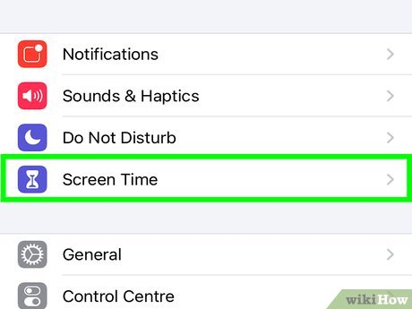
Monitor Your Screen Time on Your iPhone
Go to “Settings” and select “Screen Time”
Tap “Turn On Screen Time”
Tap “Continue”
Select “This is My [device]” or “This is My Child's [device]”
After you turn on Screen Time, you'll see a report showing how you use your device, apps, and websites.

Slide 9
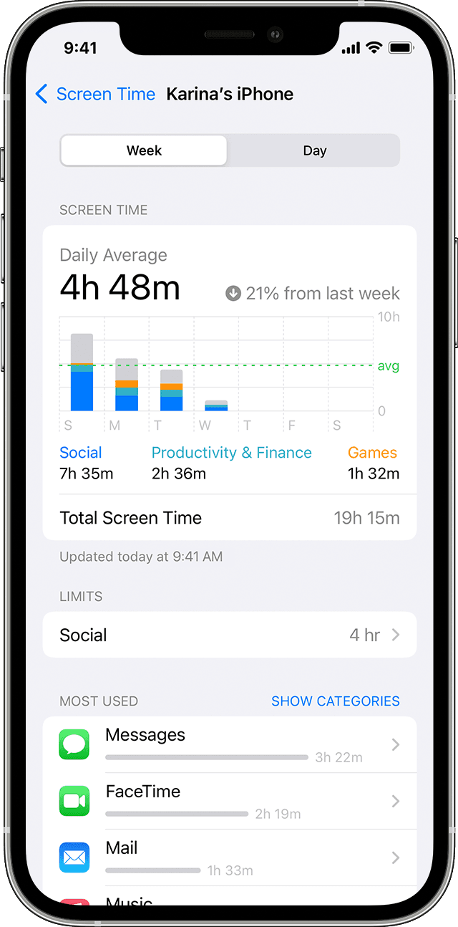
Screen Time Report for iPhone
To see the report, go to “Settings” and select “Screen Time” and tap “See All Activity” under the graph
From there, you can see your usage, set limits for your most used apps, and see how many times a device was picked up or received a notification

Slide 10
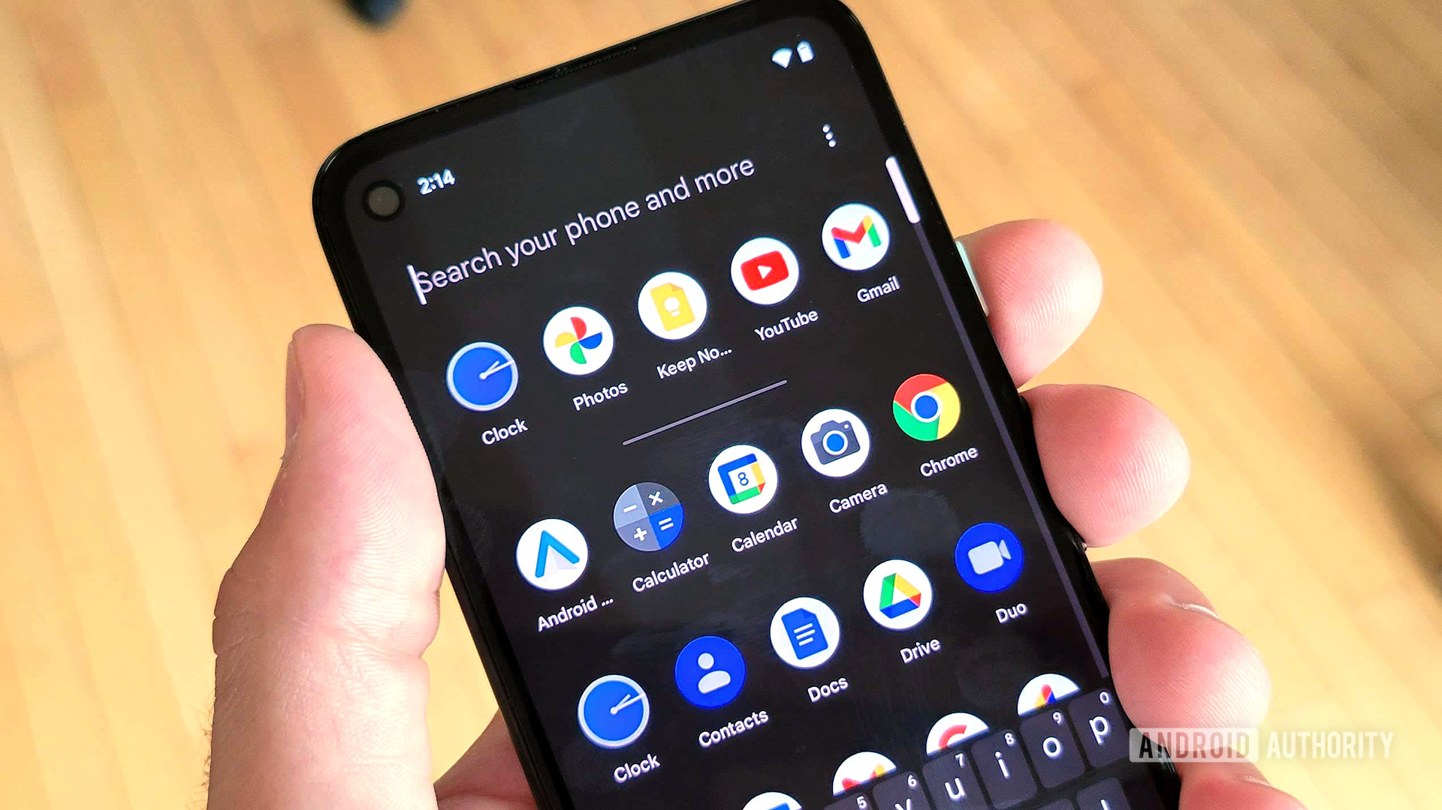
Monitor Your Screen Time on Your Android
Open the “Digital Wellbeing” app by going to your Settings app and then turn on ”Show Icon” in the app list
The first time you open Digital Wellbeing, you need to set up your profile
Open your phone’s Settings app
Tap ”Digital Wellbeing & Parental Controls”
Under “Your Digital Wellbeing Tools,” tap ”Show your Data”

Slide 11
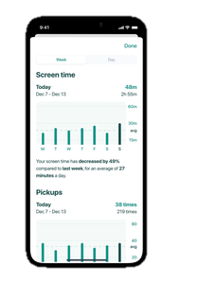
Screen Time Report for Android
Open your phone's Settings app
Tap ”Digital Wellbeing & Parental Controls”
The chart shows your phone use today
  Screen time: What apps you've had on screen and for how long
  Unlocks: How often you've unlocked your phone and opened certain apps
  Notifications: How many notifications you've gotten and from which apps
To get more info or change app settings, tap a listed app

Slide 12
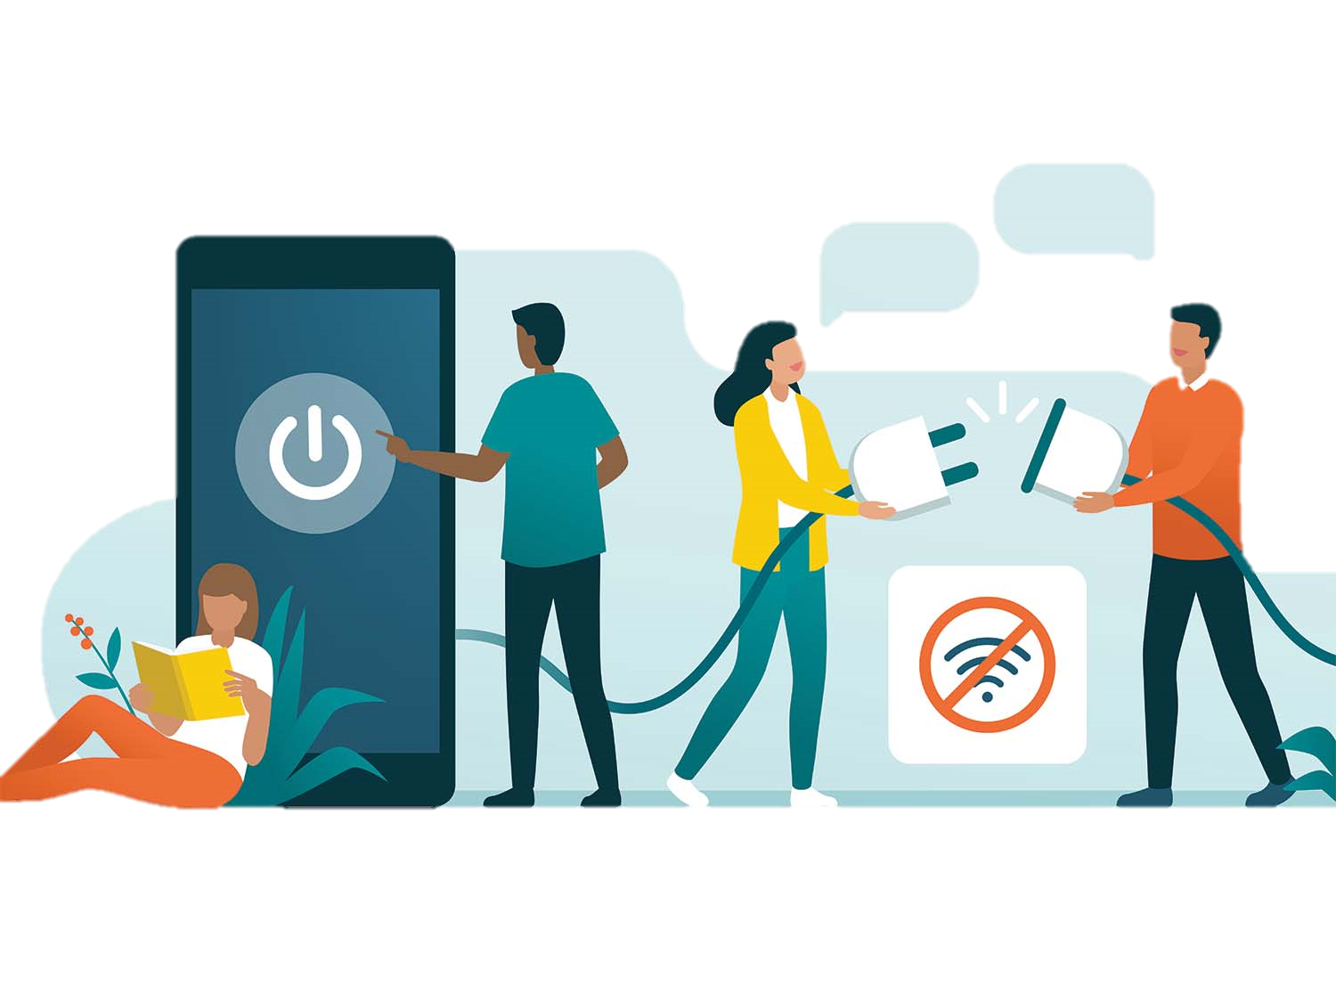
Do a Detox
Are you feeling like you may spend too much on your devices?
Research has found doing a digital detox may help improve your sleep, relationships, and stress
It may be impossible to go “cold turkey”
Taking small steps to decrease screen
  time is okay

Slide 13
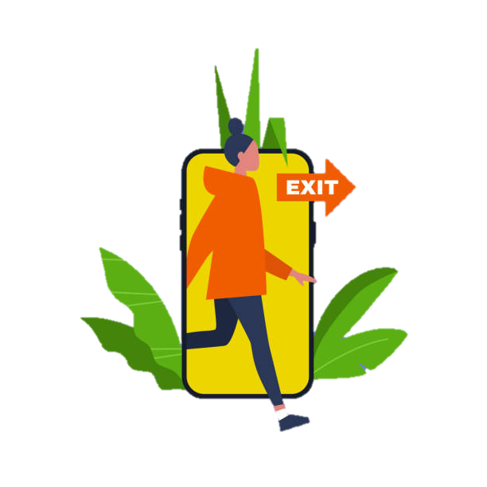
Ways to Cut Back Screen Time
Track your screen time
Create accountability
Be reasonable
Be active…without screen time
Make a daily appointment for no-screen time
Notes:
Track screen time: it’s kind of ironic, but you can track your screen time with a mobile app. Or you can keep a journal or calendar to track your screen time. Do this for at least a week.
You’ll get a snapshot of what your screen time activity looks like, along with the way your usage fluctuates throughout the day. It’s a starting point that can help you create a plan to cut back on screen time.
Create accountability: Once you have an idea of what your screen time looks like, share your idea to cut back on screen time with someone who will hold you accountable. Ask a family member, friend, or co-worker, to follow-up with you about screen time. You’ll be more likely to actually unplug.
Be reasonable
Remember…the cold-turkey method to give up all screen time just isn’t realistic for most people. Set a reasonable goal, like reduce screen time by 1 hour per day. Stick with it for an entire week. Evaluate how it goes. Then set a new goal.
Be active…without screen time
If you’re addicted to podcasts, music, movies, checking email, or the steady stream of social media posts, turn off your phone and step away from the screen. And be more active. Take a walk. Go for a bike ride. Work in the yard. Play with your kids. Aim for 30 to 60 minutes of moderate physical activity a day. You’ll burn extra calories, and you’ll feel better.
Make a daily appointment for no-screen time
Instead of constantly watching a screen (TV, phone, tablet, computer, and other devices), make an appointment for no screen time every day. Put it on your calendar just like you would an important appointment. For example, no screen time during meals or while you’re getting ready for the day. Or no screen time beginning two hours before bed.

Slide 14
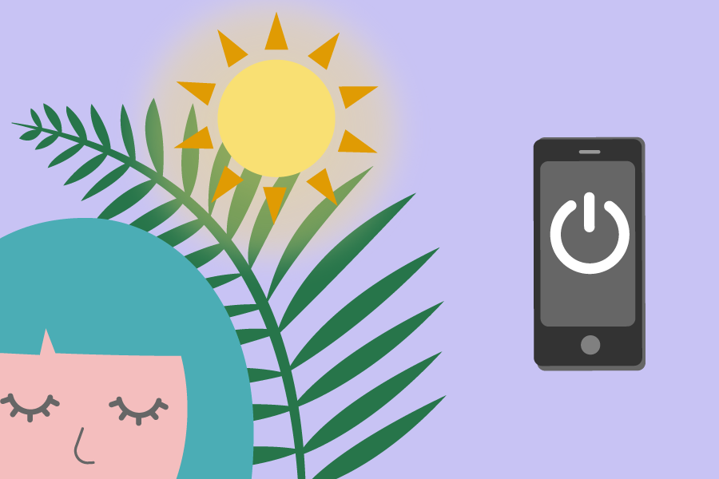
Taking Back Your Time
At first, you might find it hard to adjust, but you can do it
During your no-screen-time hours, have a conversation with someone, play a game, read a book, exercise, or enjoy a hobby
For most people, some screen time is an everyday part of life, but it doesn’t have to control your life
Want to cut back on screen time? Now is always the best time to start

Slide 15
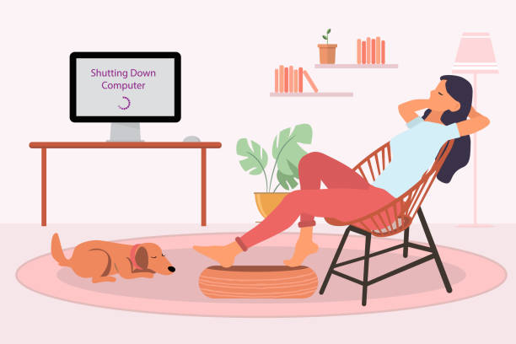
Replacing Screen Time
Go for a bike ride or walk
Visit a park
Visit a museum or explore a local nature trail
Try coloring (it’s healthy for adults, too)
Reading
Crafting
Turning off electronics during meals or family time eliminates distractions
Find events in your community
Meet a friend for coffee and leave phone in your purse or pocket on silence
Notes:
Events in your community: Time spent using devices can instead be used for volunteering, joining a sports team or connecting time with a spiritual group.

Slide 16

Summary
No matter what your motivation or reason is for cutting back or monitoring screen time, you should see a difference in your day to day life, relationships, as well as productivity and overall well-being
Try to take back YOUR time starting today!

Slide 17
Challenge
Download the PDF

Slide 18
Sources
https://www.healthline.com/health/the-mental-health-effects-of-being-constantly-online#Screen-time-and-depression
https://mcpress.mayoclinic.org/healthletter/5-ways-slimming-screentime-is-good-for-your-health/
https://support.google.com/android/answer/
https://support.apple.com/guide/iphone/view-your-screen-time-summary

